Slide 1

Agile certified practitioner - (PMI-ACP) Prep Course 3 day workshop
Hari Prasad Thapliyal
MCA, MBA (Operations), PGDFM, ZED Master Trainer, PMP, MCITP,
PMI-ACP, PRINCE2 Practitioner, SCT, CSM, MCT, SDC, SCM, SPOC, SAMC
[PMI-ACP : #318050]
[PMP : #1563385]
EasyLearning Tre
D-8,2nd Floor,S.R.Residency.3rd Cross, Chocolate factory road, Near Swaraj Hyper Market,
BTM-1ST stage Bangalore – 560029. Karnataka
'PMI-ACP', 'PMI', and 'ACP' are a registered marks of the Project Management Institute, Inc.
'PMI-ACP', 'PMI', and 'ACP' are a registered marks of the Project Management Institute, Inc.

Slide 2
Faculty & Participants An Introduction
Name, Company, Current Designation, Why Certification, Hobby

Slide 3
Workshop Ground Rules
Please keep your mobile on the silent mode. Always take your calls outside the training room.
No corner talk! Discussions only when group discussion is allowed
Keep your focus on the ongoing topic. Await your turn during the questionnaire round.
Strictly follow the workshop schedule for management of time.
There is parking lot. Write you questions and post with your name on parking lot.
Breaks only on agreed time
Tea
Lunch
Tea
Everybody need to contribute
Use your experience only for relating the processes and best practices. To avoid confusion keep it outside of the class. Unlearning is first and biggest learning to learn something new.
Two Bowls
Notes:
Project Management Concepts
06/28/13
Version 3.1, 4/01 © 2003 by AstroWix
3

Slide 4
Workshop Objective
Learn Agile Project Management best Practices as per PMI-ACP certification requirements
Build confidence to handle day to day Agile Project Management Challenges
Getting accustomed to new terminology of Agile Project Management
Understand the PMI-ACP ® certification process
Get familiarize with number of multiple choice questions in line with the PMI-ACP ® Certification
Build confidence to face the PMI-ACP ® examination challenge
Notes:
Project Management Concepts
06/28/13
Version 3.1, 4/01 © 2003 by AstroWix
4

Slide 5
PMI® & PMI-ACP® An Overview
Notes:
Project Management Concepts
06/28/13
Version 3.1, 4/01 © 2003 by AstroWix
5

Slide 6
PMI® - Overview
Largest, not-for-profit global professional association for project management practitioners
Established in 1969
Governed by a Board of Directors; elected “volunteer” members
PMI Office is in Newtown Square, Pennsylvania in the USA.
Truly global membership with representation in over 190 countries.
Chapters act as “franchises”, providing education and networking opportunities
35+ Community of Practices. These are created based on industry or project management subjects
Notes:
Project Management Concepts
06/28/13
Version 3.1, 4/01 © 2003 by AstroWix
6
Project Management Institute
PMI is the largest, not-for-profit global professional association for project management practitioners with over 100,000 members worldwide which had been providing advancement of the profession of project management knowledge since 1969. The Institute can help provide tools professionals need to transform their organization. PMI is governed by a Board of Directors which is comprised of elected “volunteer” members of the organization. The Policies of the association are implemented through the professional staff who are located at the PMI Offices in Newtown Square, Pennsylvania in the United States of America.
PMI has a truly global membership, with representation in over 130 countries. Currently there are about 300 organizations participating in our Group Billing Plan. They have almost 300 chartered and potential Chapters working toward their charters. These Chapters act as “franchises” of PMI, providing education and networking opportunities to their members located in their regions or local areas. There are Specific Interest Groups, or SIGs, are designed to bring project management practitioners in similar industries or with similar interests together in a virtual environment.
There are currently 30 SIGs and 6 potential SIGs.
Member Benefits As a PMI member, you receive many valuable benefits that help to promote your professional and career development. These benefits include access to member’s only services as well as discounts on many of PMI’s valuable products. Member’s Only Service
Free Copy of the latest edition of the PMBOK® Guide CD ROM
Subscriptions to PM Network®, Project Management Journal® and PMI Today™
Join PMI’s Chapters, Specific Interest Groups (SIGs) and Colleges
Access the Members Area of the Web site
Access the PMI Member Community online
PMP Certification Benefits
For individuals, the PMP certification:
Provides professional and personal recognition
Expedites professional advancement
Creates job growth and opportunities within an organization
Provides a framework for standardized project management requirements
Increases an employee’s value to the organization
A major benefit that organizations can receive via the PMP Program is that the PMP is a truly global certification.
It is considered the profession’s most global credential because it is developed by a global network of PMPs who participate in the development of the examination and the program requirements.
With today’s multi-national companies, organizations can be assured that their PMP-certified project management practitioners are speaking the same language within the practice of project management.

Slide 7
PMI® – Membership Benefits
Get member’s only discount on many of PMI’s valuable products
Free Access to all PMI Standards
Subscriptions to PM Network®, Project Management Journal® and PMI Today™
Access the Members Area of the Web site
Access the PMI Member Community online
Notes:
Project Management Concepts
06/28/13
Version 3.1, 4/01 © 2003 by AstroWix
7
Project Management Institute
PMI is the largest, not-for-profit global professional association for project management practitioners with over 100,000 members worldwide which had been providing advancement of the profession of project management knowledge since 1969. The Institute can help provide tools professionals need to transform their organization. PMI is governed by a Board of Directors which is comprised of elected “volunteer” members of the organization. The Policies of the association are implemented through the professional staff who are located at the PMI Offices in Newtown Square, Pennsylvania in the United States of America.
PMI has a truly global membership, with representation in over 130 countries. Currently there are about 300 organizations participating in our Group Billing Plan. They have almost 300 chartered and potential Chapters working toward their charters. These Chapters act as “franchises” of PMI, providing education and networking opportunities to their members located in their regions or local areas. There are Specific Interest Groups, or SIGs, are designed to bring project management practitioners in similar industries or with similar interests together in a virtual environment.
There are currently 30 SIGs and 6 potential SIGs.
Member Benefits As a PMI member, you receive many valuable benefits that help to promote your professional and career development. These benefits include access to member’s only services as well as discounts on many of PMI’s valuable products. Member’s Only Service
Free Copy of the latest edition of the PMBOK® Guide CD ROM
Subscriptions to PM Network®, Project Management Journal® and PMI Today™
Join PMI’s Chapters, Specific Interest Groups (SIGs) and Colleges
Access the Members Area of the Web site
Access the PMI Member Community online
PMP Certification Benefits
For individuals, the PMP certification:
Provides professional and personal recognition
Expedites professional advancement
Creates job growth and opportunities within an organization
Provides a framework for standardized project management requirements
Increases an employee’s value to the organization
A major benefit that organizations can receive via the PMP Program is that the PMP is a truly global certification.
It is considered the profession’s most global credential because it is developed by a global network of PMPs who participate in the development of the examination and the program requirements.
With today’s multi-national companies, organizations can be assured that their PMP-certified project management practitioners are speaking the same language within the practice of project management.

Slide 8
PMI-ACP® – Certification Benefits
Provides professional and personal recognition
Expedites professional advancement
Creates job growth and opportunities within an organization
Provides a framework for standardized project management requirements
Increases an employee’s value to the organization
You have a truly global certification.
PMI Certified Project Managers are a preferred lot by any organizations worldwide
High Demand due to short supply of Certified Agile Project Managers
Increase in compensation within the organization
Notes:
Project Management Concepts
06/28/13
Version 3.1, 4/01 © 2003 by AstroWix
8
Project Management Institute
PMI is the largest, not-for-profit global professional association for project management practitioners with over 100,000 members worldwide which had been providing advancement of the profession of project management knowledge since 1969. The Institute can help provide tools professionals need to transform their organization. PMI is governed by a Board of Directors which is comprised of elected “volunteer” members of the organization. The Policies of the association are implemented through the professional staff who are located at the PMI Offices in Newtown Square, Pennsylvania in the United States of America.
PMI has a truly global membership, with representation in over 130 countries. Currently there are about 300 organizations participating in our Group Billing Plan. They have almost 300 chartered and potential Chapters working toward their charters. These Chapters act as “franchises” of PMI, providing education and networking opportunities to their members located in their regions or local areas. There are Specific Interest Groups, or SIGs, are designed to bring project management practitioners in similar industries or with similar interests together in a virtual environment.
There are currently 30 SIGs and 6 potential SIGs.
Member Benefits As a PMI member, you receive many valuable benefits that help to promote your professional and career development. These benefits include access to member’s only services as well as discounts on many of PMI’s valuable products. Member’s Only Service
Free Copy of the latest edition of the PMBOK® Guide CD ROM
Subscriptions to PM Network®, Project Management Journal® and PMI Today™
Join PMI’s Chapters, Specific Interest Groups (SIGs) and Colleges
Access the Members Area of the Web site
Access the PMI Member Community online
PMP Certification Benefits
For individuals, the PMP certification:
Provides professional and personal recognition
Expedites professional advancement
Creates job growth and opportunities within an organization
Provides a framework for standardized project management requirements
Increases an employee’s value to the organization
A major benefit that organizations can receive via the PMP Program is that the PMP is a truly global certification.
It is considered the profession’s most global credential because it is developed by a global network of PMPs who participate in the development of the examination and the program requirements.
With today’s multi-national companies, organizations can be assured that their PMP-certified project management practitioners are speaking the same language within the practice of project management.

Slide 9
PMI Standards
Foundation Standards
PMBOK Guide 5th Edition, 2013/ 6th , 2016
Portfolio Management, 3rd Edition
Program Management, 3rd Edition
OPM3, 3rd Edition
Practice Standards
Practice Standard for Earn Value Management, 2nd
Practice Standard for Schedule Management, 2nd
Practice Standard for Risk Management
Practice Standard for Project Estimating
Practice Standard for Configuration Management
Practice Standard for Work Break Down Structure
Project Manager Competency Development Framework Profession
Practice Guides
Agile Practice Guide
Requirement Management Practice Guide
Governance of Portfolios, Program, Projects: A Practice Guide
Business Analysis for Practitioners: A Practice Guide
Implementing Organization Project Management: A Practice Guide
Navigation Complexity: A Practice Guide
Lexicon of Project Management Terms
Extensions
Construction Extension
Government Extensions

Slide 10
Certifications from PMI
Certified Associate in Project Management (CAPM)® certification
PMI Agile Certified Practitioner (PMI-ACP)® certification
PMI Risk Management Professional (PMI-RMP)® certification
PMI Scheduling Professional (PMI-SP)® certification
Portfolio Management Professional (PfMP) ® certification
Program Management Professional (PgMP)® certification
Project Management Professional (PMP)® certification
PMI Professional in Business Analysis (PMI-PBA)® certification

Slide 11
PMI-ACP Exam Prerequisite
Certification Body : PMI (Project Management Institute, USA)
Education : Secondary Degree
Experience Required to apply for certificate: 2000 hours (12 Months) general project management experience in last 5 years+ 1500 hours (8 months) experience in agile project management in last 3 years.
Minimum Efforts Required to pass the exam: After taking 21 contact hours training on agile project management around 2 months efforts required to pass the exam.
Audit : 25% of the applications submitted for PMI-ACP exam get audited randomly.

Slide 12
Exam Fees, Validity, Exam
Exam Fees : Fees for PMI members : $435, Fees for PMI non-members: $495
Re-Exam Fees : Fees for PMI members : $335, Fees for PMI non-members: $395
Renewal Fees : $60 (for members), $150 (for non-members). Certificate is valid for next three years.
Validity of certificate : Certificate is valid only for 3 years. Within 3 years certified person need to accumulate 30 PDUs (agile project management) and submit to PMI through online interface.
Exam : 3 hours. 120 questions. Close book exam. Passing Score not known. Online exam. 20 questions are experimental and they do not carry any score.
https://www.pmi.org/certifications/types/agile-acp
http://www.pmi.org/-/media/pmi/documents/public/pdf/certifications/agile-certified-exam-outline.pdf

Slide 13
PMI-ACP Certification Process
Go through PMI-ACP training and get 21 Contact hours training
Get your experience data ready
Submit your application
Get your PMI-ACP application approved
Pay your PMI-Exam Fees
Book your exam at Prometric Center
Write you exam & Pass
Maintain your certificate for another 3 years by accumulating 30 PDU

Slide 14
Earning 30 PDU for Maintaining PMI-ACP
Before 3rd anniversary of your PMI-ACP certificate accumulate 30 PDU in 3 years and pay $90 to renew your certificate for another 3 years. 30 PDU accrued towards PMI-ACP certificate renewal can also be used for PMP certificate renewal.

Slide 15
Ways to get 30 PDUs
Update your Agile Project Management Knowledge
Attend some training on agile project management
Self paced on-line training on agile project management
Giving Back to society
Co-author Agile PM book
Participate in Agile Project Management Events
Write Paper /Article/ Blogs on Agile PM
Speak on Agile Project Management from PMI platforms
Conduct Agile PM related trainings
Manage Projects using Agile Methodolgoies

Slide 16
Topics for Examination
# | Domain | # Sub Domain | # Tasks | %
1 | Agile Principles & Mindset |  | 9 | 16%
2 | Value Driven Delivery | 4 | 15 | 20%
3 | Stakeholder Engagement | 3 | 9 | 17%
4 | Team Performance | 3 | 9 | 16%
5 | Adaptive planning | 3 | 10 | 12%
6 | Problem detection and resolution |  | 5 | 10%
7 | Continuous Improvement (Product, Process, People) |  | 6 | 09%
7 Domains for PMI-ACP Exam
Total = 63 Major Tasks
Notes:
Project Management Concepts
06/28/13
Version 3.1, 4/01 © 2003 by AstroWix
16

Slide 17
Sub-Domains
Value Driven Delivery
Define Positive Value- 3
Avoid Potential Downsides – 3
Prioritization -3
Incremental Development-5
Stakeholder Engagement
Understand Stakeholder Needs-2
Ensure Stakeholder Involvement-3
Manage Stakeholder Expectations-4
Team Performance
Team Formation-2
Team Empowerment-3
Team Collaboration and Commitment-4
Adaptive planning
Levels of Planning-3
Adaptation-2
Agile Sizing and Estimation-5

Slide 18
11 Books Recommended by PMI for PMI-ACP Exam
1 | Agile Retrospectives: Making Good Teams Great, Author: Esther Derby, Diana Larsen, Ken Schwaber, ISBN #0977616649
2 | Agile Software Development:The Cooperative Game – 2nd Edition, Author: Alistair Cockburn, ISBN #0321482751
3 | The Software Project Manager’s Bridge to Agility, Author: Michele Sliger, Stacia Broderick, ISBN #0321502752
4 | Coaching Agile Teams, Author: Lyssa Adkins, ISBN #0321637704
5 | Agile Project Management:Creating Innovative Products – 2nd Edition, Author: Jim Highsmith, ISBN #0321658396
6 | Becoming Agile in an imperfect world, Author: Greg Smith, Ahmed Sidky, ISBN #1933988258
7 | Agile Estimating and Planning, Author: Mike Cohn, ISBN #0131479415
8 | The Art of Agile Development, Author: James Shore, ISBN #0596527675
9 | User Stories Applied:For Agile Software Development, Author: Mike Cohn, ISBN #0321205685
10 | Agile Project Management with Scrum, Author: Ken Schwaber, ISBN #073561993X
11 | Lean-Agile Software Development: Achieving Enterprise Agility, Author: Alan Shalloway, Guy Beaver, James R.Trott, ISBN #0321532899

Slide 19
Further Reading & Practice
You must read these two handbooks for more details about PMI-ACP exam. These are available free of cost on www.pmi.org
PMI ACP Content Outline, 2014
PMI ACP Handbook Jan-2016
You are recommended to practice simulation exam
https://edward-designer.com/web/free-pmi-acp-exam-questions/
https://www.greycampus.com/opencampus/agile-certified-practitioner/11/take-quiz
https://www.project-management-prepcast.com/free/pmi-acp-exam/free-questions
If possible read following book for deeper understanding of concepts. This is one of the book recommended by PMI
The Art of Agile Development, Author: James Shore, ISBN #0596527675
http://www.jamesshore.com/Agile-Book/assess_your_agility.html

Slide 20
Notes:
Project Management Concepts
06/28/13
Version 3.1, 4/01 © 2003 by AstroWix
20

Slide 21
Agenda
Introduction
10 Tools & Techniques
33 Knowledge and Skills

Slide 22
Disclaimer
Agile project management (APM) is vast subject to cover in 21 hours, so do not expect to learn and know everything of APM in 3 days. ☺ ☹
This training is based on PMI-ACP Examination Content Outline July 2014. So it does not promote any agile software tool or methodology. ☺
Training is designed to help potential PMI-ACP candidates in preparing for PMI-ACP exam ☺
After the training you should study around 100 hours along with simulation exams and reference books suggested by PMI before you write your final PMI-ACP exam. ☹
We highly appreciate your specific feedback to improve quality of training material :-
Notes:
22

Slide 23
Some Confusing Terminologies
Values -> Principles -> Practices
Values and Principles are Unchanging foundation in Agile. Practices are industry specific.
Principles are based on values. Practices are based on Principles
Knowledge & skills are virtues of the person to whom they belongs
Tools & Techniques are external to the person they are not virtues of person.
You need to have knowledge & master the skill to deliver good results in some field of work but available tools and techniques improves the quality, reduce time and cost.
Examples
Mary can conduct a online-training workshop on project Management. In this case
Tool & Tech: Online Training Workshop Facilitation
Knowledge & Skills : Subject knowledge about Project Management
Ram can make table
Knowledge & Skills: Knowledge about wood, designs, skill of carpentering.
Tools & Tech: Wood, hammer, saw etc.

Slide 24
Introduction : Project Management

Slide 25
Topics
Introduction / Project Management
Project
Project Management
Program Management
Portfolio Management
Program Management Office
Stakeholders
Organization Types
Responsibilities of a Project Manager

Slide 26
What is Project???
Introduction / Project Management

Slide 27
What is Project?
Introduction / Project Management
Project – A temporary endeavor undertaken to create a unique product, service or result
How Temporary?
Has a definite beginning and end, not an on-going effort
Ceases when objectives have been attained
Team is disbanded upon project completion
Unique?
The product or service is different in some way from other product or services
Product characteristics are progressively elaborated
Source PMBOK Guide Version 5.0

Slide 28
Project ..…
Project Characteristics
Introduction / Project Management
Is goal oriented (verifiable and measurable)
Finite duration with a beginning and end
Uniqueness to a great extent and related uncertainties
Coordinated undertaking of interrelated activities
Performing the activities involve resources
Resources cost money

Slide 29
“Projects” different from “operations”?
Contrast Projects & Operations
Introduction / Project Management
Projects
Permanent Project Charter
Catalyst for change
Unique product or service
Heterogeneous teams
Start and end date
Progressive elaboration
Operations
Semi-permanent charter
Maintains status quo
Standard product or service
Homogeneous teams
Ongoing
Predefined product

Slide 30






Project Constraints
Project Constraints
Introduction / Project Management
Risk
Scope
Project and Product Quality
Schedule
Cost
Resource

Slide 31
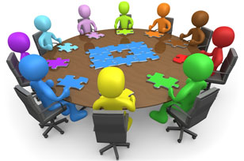
Project Management?
Project Management
Introduction / Project Management
The application of knowledge, skills, tools and techniques to project activities in order to meet the project requirements
Requirements are put by
Stakeholders

Slide 32
Project Phases
Project Phases
Introduction / Project Management
A project is divided into phases where extra control is required to effectively manage the completion of the major deliverables
Collectively, the project phases put together is known as Project life cycle (PLC)
Each phase is marked by one or more tangible verification work product
The conclusion of a project phase is generally marked by a review
The phase end points are referred to as phase exits, milestones, phase gates, decision gates, stage gates or kill points
Starting a phase before approval of deliverables of a previous phase is called Fast Tracking

Slide 33
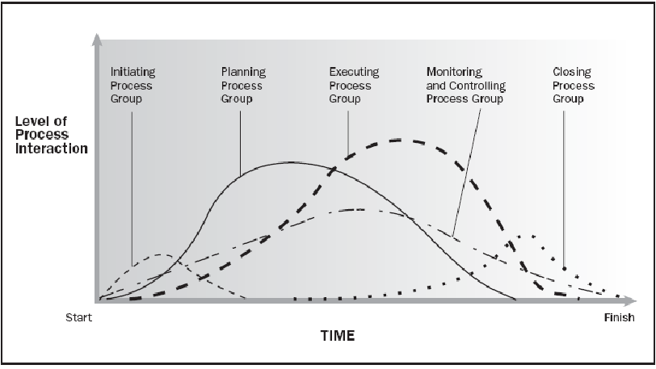
Typical PLC & Level of Activities
Introduction / Project Management
Source PMBOK Guide Version 5.0

Slide 34
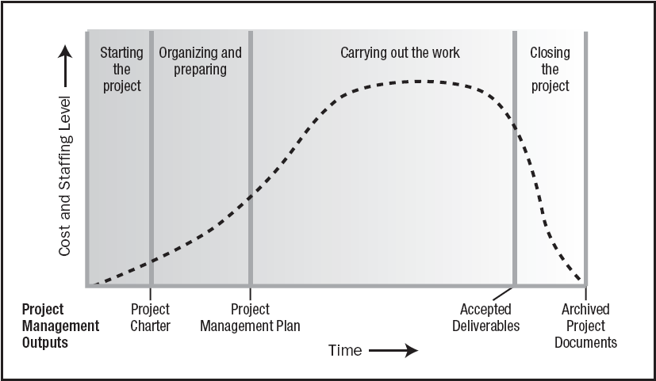
Typical Costing & Staffing across PLC
Introduction / Project Management
Source PMBOK Guide Version 5.0

Slide 35
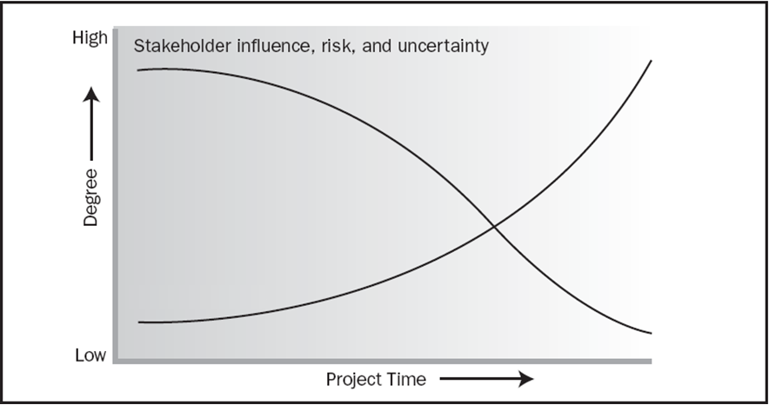
Impact of Variables based on Time
Introduction / Project Management
Cost of Change in Traditional PM
Cost of Change in Agile PM
Original Slide from PMBOK Guide Version 5.0

Slide 36
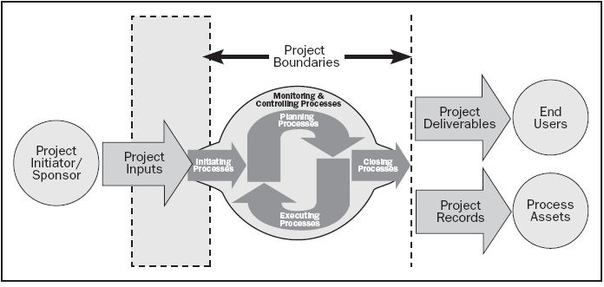
Project Boundaries
Introduction / Project Management
Source PMBOK Guide Version 5.0

Slide 37
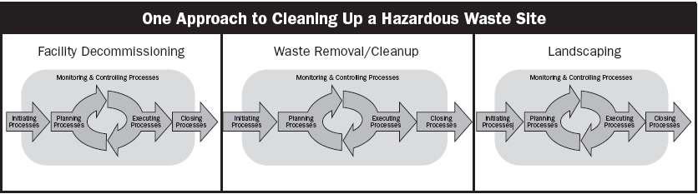
Relationship between Process Group & Phases
Introduction / Project Management
Source PMBOK Guide Version 5.0

Slide 38
What is Program?
Project Management Context
Introduction / Project Management
Group of related projects managed in a coordinated way to obtain benefits and control not available from managing them individually

Slide 39
Project Portfolio Management
Project Management Context
Introduction / Project Management
Collection of projects or programs and other work that are grouped together to facilitate effective management of that work to meet strategic business objectives
Portfolio manager is responsible for prioritizing project or programs, seek funding for his portfolio project

Slide 40
What is PMO?
Project Management Office
Introduction / Project Management
Managing shared resources across all project administered by PMO
Identifying and developing project management methodologies, best practices and standards
Coaching, mentoring, training and oversight
Monitoring compliance with project management standards, policies, procedures and templates via project audits
Developing and managing project policies, procedures, templates and other shared documentation (organizational process assets), and
Coordinating communication across projects

Slide 41
Who are Stakeholders?
Stakeholders
Introduction / Project Management
Persons or organizations who are actively involved in the project or whose interests maybe positively or negatively affected by the performance or completion of the project
Source PMBOK Guide Version 5.0

Slide 42
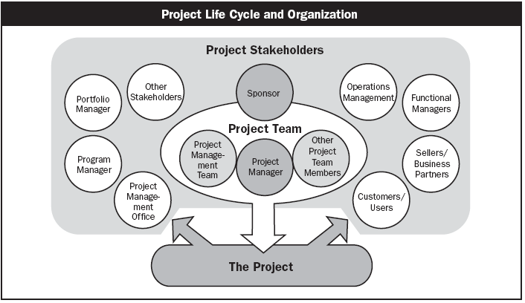
Who are Stakeholders?
Introduction / Project Management
Source PMBOK Guide Version 5.0

Slide 43
Organizational Types
Introduction / Project Management
Functional
Matrix
Weak Matrix
Balanced Matrix
Strong matrix
Projectized

Slide 44
Functional
Introduction / Project Management
Project Coordination
Chief Executive
Functional Manager
Functional Manager
Functional Manager
Staff
Staff
Staff
Staff
Staff
Staff
Staff
Staff
Staff

Slide 45
Weak Matrix
Introduction / Project Management
Chief Executive
Functional Manager
Functional Manager
Functional Manager
Staff
Staff
Staff
Project Coordination
Staff
Staff
Staff
Staff
Staff
Staff

Slide 46
Balance Matrix
Introduction / Project Management
Chief Executive
Functional Manager
Functional Manager
Functional Manager
Staff
Staff
Staff
Staff
Staff
Staff
Project Coordination
Project Manager
Staff
Staff

Slide 47
Strong Matrix
Introduction / Project Management
Chief Executive
Functional Manager
Functional Manager
Functional Manager
Manager of Project Managers
Staff
Staff
Staff
Project Manager
Staff
Staff
Staff
Project Manager
Staff
Staff
Staff
Project Manager
Project Coordination

Slide 48
Projectized Matrix
Introduction / Project Management
Project Coordination
Chief Executive
Project Manager
Project Manager
Project Manager
Staff
Staff
Staff
Staff
Staff
Staff
Staff
Staff
Staff

Slide 49
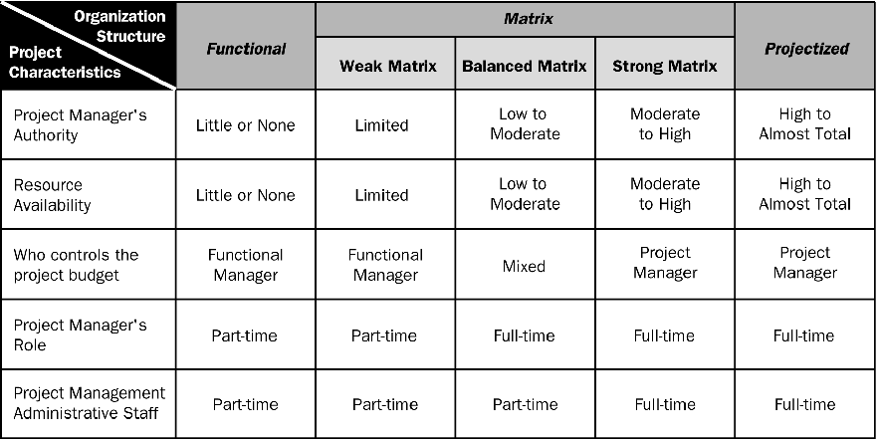
Organizational Influence
Introduction / Project Management
Source PMBOK Guide Version 5.0

Slide 50
PM Competencies
Introduction / Project Management
Project Manager Competency Development Framework- 2nd Edition, 2007

Slide 51
Responsibilities of a Project Manager
Project Manager’s Role
Introduction / Project Management
Estimates of size, efforts & schedule
Risk identification, analysis, prioritization, monitoring & control
Resource allocation, resource backup and utilization
Scope management
Communication- reviews, steering committee meetings, stakeholder identification and expectation management
Stakeholder Expectation Management
Defect free product delivery on time within budget
Team motivation, team management, training & development, appreciation, career planning, interview
Deliver as per contract & proposal
Procure as per contract & proposal
Configuration management, data backup
Quality planning
Cost optimization
Presales & proposals
Technical guidance to team – if team members are not available do their work (after project manager has completed his work & he has spare time)
In agile projects, project manager works as a servant leader, facilitator, impediment remover, watchdog for processes and firewall for the team

Slide 52
Responsibilities of a Project Manager
Project Manager’s Responsibilities in Project Lifecycle
Introduction / Project Management
Initiating a Project
Project aligned with org objectives & customer needs
High-level risks, assumptions and constraints are understood
Stakeholders identified and their need are understood
Project Charter approved
Planning a Project
Project scope agreed
Project schedule approved
Cost budget approved
Project team identified with roles and responsibilities agreed
Communication activities agreed
Quality management process established
Risk response plan approved
Integrated change control processes defined
Procurement plan approved
Project Plan approved

Slide 53
Responsibilities of a Project Manager
Project Manager’s Responsibilities in Project Lifecycle
Introduction / Project Management
Executing a Project
Project scope achieved
Project stakeholders expectations managed
Human resource managed
Quality managed against plan
Material resources managed
Monitoring & Controlling a Project
Project tracked and status communicated to stakeholders
Project change is managed
Quality is monitored and controlled
Risk is monitored and controlled
Project team managed
Contract administered
Closing a Project
Project outcomes accepted
Project resources released
Stakeholder perceptions measured and analyzed
Project formally closed

Slide 54
Project Manager Competencies
Personal Competence
Introduction / Project Management
Communication
Leading
Managing
Cognitive Ability
Effectiveness
Professionalism

Slide 55
Recap
Introduction / Project Management
Project
Project Management
Program Management
Portfolio Management
Program Management Office
Stakeholders
Organization Types
Responsibilities of a Project Manager

Slide 57
Introduction : Agile Project Management
Notes:
57

Slide 58
Topics
Introduction / Agile Project Management
Modern Project Management Challenges
How to address modern day PM challenges?
Challenges in Starting Agile Project Management
What is Agility?
Which Project Management Methodology is best?
Type of Systems
Complex Adaptive Systems (CAS)
Defined vs Empirical Processes
Values in Agile Manifesto
Agile Principles
Agile Methodologies
When Does Agile Methodologies Works Best?
Agile Project Lifecycle
Value Delivery & Project Life Cycle
Agile practices vs PMBoK Processes
Notes:
58

Slide 59
Before we go ahead…
Introduction / Agile Project Management
Lets see one case study on agile project management

Slide 60
How do you manage these
Government changes some policy overnight and it impacts your business hugely
You are a district magistrate, due to heavy rain city floods profusely
People stuck in coal mine because of some accident
Competitor comes with a disruptive product in the market
Terrorist attack in the market and you are police commissioner of the city
You want to go to mount Everest
Next month is your exam and you fall sick
You have to shift house and heavy rain happens all of student
You want to teach you child how to walk and speak your mother tongue.

Slide 61
Modern Project Management Challenges
Introduction / Agile Project Management
Uncounted uncertainties
Very tough to negotiate with stakeholders a change in baselined plan
Product value realization at the end of project lifecycle
Huge difference between expectations of end user, customer and sponsor
Typically development team is isolated from business scenario and it becomes very difficult to implement change request
Technology and project environment changes during project execution
Customer does not want to hear about new timelines even after requirement changes. Because project is baselined!
Customer end up paying more because critical dates missed, non-usable product features, less-value product
Not enough decentralized power stations to make decisions during project execution
Execution team and project management teams are different. Execution team does not have power and execution does not happen as per initial plan
Work product delivered at the end of every phase is not usable work product. Typical it is some paper prototype, document or some other thing.
Notes:
61

Slide 62
How to address modern day PM challenges?
Introduction / Agile Project Management
Involve end user
Engage relevant stakeholders
Produce in increment
Deliver high value feature first
Take frequent feedback and allow customer to change original requirements
Allow customer to prioritize
Get commitment from team for valuable product not of activities
Employ the power of level of planning
Involve team in risk identification and responding to risk
Transparency in project management
Continuous improvement
Learn quickly
Notes:
62

Slide 63
Challenges in Starting Agile Project Management
Introduction / Agile Project Management
Team
Getting experienced team member
Getting 100% committed team
Getting collocated team in early agile adoption
Team’s mindset shifting from action to delivery
A cross disciplined team with generic skills
Environment
Trust building
Open communication with customer
Keeping politics out
Infrastructure & Support
Active risk management framework
Robust, flexible and adaptable configuration and data management systems
You need a variety of communication, collaboration, management and development tools. Therefore a culture is required to support and facilitate this endeavors.
Management need a framework from where they get to know what is happening in the project.
Upfront training
Supporting in early period when velocity is less

Slide 64
What is Agility?
Introduction / Agile Project Management
Agility is about quickly responding to changes
Learning quickly from mistakes and incorporate lessons learned
Being proactive
It helps in all aspects of success- Personal, Technical and Organizational
Notes:
64

Slide 65
What is Agility?
Introduction / Agile Project Management
How agility is possible with complex, bureaucratic, gigantic processes.
Traditional processes are reactive in nature, they learn very late, respond very slow
Notes:
65

Slide 66
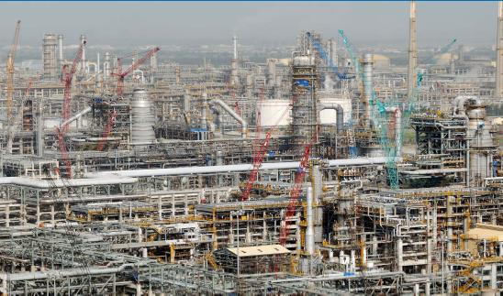
What is Agility?
Introduction / Agile Project Management
This refinery along with township in Jamnagar, Gujarat, India was completed in 1999 in 36 months.
There was the time when over 100,000 people working on the project on any particular day and sponsor was paying rental for a crane Rs 10 million every day.

Slide 67
Which PM Methodology is best?
Introduction / Agile Project Management
Process<- Orientation -> People
Agile Project Management
Low <- Certainty ->High
Traditional Project Management

Slide 68
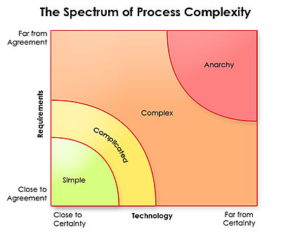
Which PM Methodology is best?
Introduction / Agile Project Management
Nothing works here
Ralph Stacey's complexity matrix
Waterfall

Slide 69
Types of Systems
Introduction / Agile Project Management
Act | Probe | Sense | Analyze | Categorize | Respond
 |  | a |  |  | a | Chaotic
a |  | a |  |  | a | Complex
 |  | a | a |  | a | Complicated
 |  | a |  | a | a | Simple

Slide 70
Types of Systems
Introduction / Agile Project Management
In your kitchen you need to make tea but you realized there is no water, milk, tea bag, sugar! First you need to sense. Then categorise to solve.
Best practices will help here. No change is required in practices. Simple.
Your school going boy is not interested in going school but you want him to go. First you need to sense the problem.
Good practices learned from your elders and friends will help you here. Little tailoring may be required. Complicated
As a head of department you want to remove corruption from your department. First you need to probe.
Practices keep emerging. Complex.
Bus, Scooter, Cycle, Tram, Car, Pedestrian using the same road to commute is chaos. First you need to act.
No practice helps here. Chaotic.

Slide 71
Types of Systems
Introduction / Agile Project Management
Agile
Order
Technical
Complexity
Structural Complexity
Disorder
Complicated
Sense
Analyse
Respond
Good Practices
Complex
Probe
Sense
Respond
Emergent Practices
Temporal
Complexity &
Directional
Complexity
Simple
Sense
Categorise
Respond
Best Practices
Novel
Act
Sense
Respond
Chaotic
Nothing works here
Waterfall
Chaos

Slide 72
Complex Adaptive Systems
Introduction / Agile Project Management
Think about how newly born child is going to learn about talking, walking, learning, eating etc.
What process you use to climb mountain?
In the last couple of decades scientists and managers have articulated a profound shift in their view about how organisms and organizations evolve, respond to change, and manage their growth.
Complex Adaptive Systems theory is one of the root threads of agile development. The concepts about how biological systems evolve and adapt have relevance, if only metaphorically, to organizations and how they evolve and adapt.
Creativity and innovation are the emergent results of well-functioning agile teams.
In complex system things get done because people adapt not because they blindly follow
Former Visa International CEO Dee Hock coined the word “chaordic” to describe both the world where Order exists in Chaos.

Slide 73
Defined vs Empirical Processes
Introduction / Agile Project Management
Defined Processes
Assumes that every piece of work is completely understood
Input is well-defined
A set of well-defined input produces same output every time within known variance limit
Has tightly coupled steps
No checkpoint and feedback steps

Slide 74
Defined vs Empirical Processes
Introduction / Agile Project Management
Empirical Processes
Relies on frequent inspections and adaption
Applies to those process which are loosely defined because of their complexity
Understand that output of a process can be unpredictable and unrepeatable

Slide 75
Value in Agile Manifesto
Introduction / Agile Project Management
“We are uncovering better ways of developing software by doing it and helping others do it. Through this work we have come to value”
Individuals and interactions over processes and tools
Working software over comprehensive documentation
Customer collaboration over contract negotiation
Responding to change over following a plan
That is, while there is value in the items on the right, we value the items on the left more.
www.agilemanifesto.org

Slide 76
Agile Principles
Introduction / Agile Project Management
Satisfy customer by continuous delivery of valuable product
Welcome Change even at late stage
Deliver working software Frequently
Business and Developer work together
Build around Motivated Individuals- Give team opportunity, trust them
Face-to-face communication
Working software is the primary measure of progress.
Sustainable Development
Continuous Technical Excellence
Simplicity--the art of maximizing the amount of work not done--is essential.
Self Organizing Team
Team reflection at regular intervals
www.agilemanifesto.org

Slide 77
Agile Core Practices
Introduction / Agile Project Management
Active Stakeholder Participation
Apply the Right Artifacts
Collective Ownership
Create Several Models in Parallel
Create Simple Content
Depict Models Simply
Display Models Publicly
Iterate to Another Artifact
Model in Small Increments
Model with Others
Prove it with Code
Single Source Information
User the Simplest Tools

Slide 78
Agile Characteristics
Introduction / Agile Project Management
Adaptability not Predictability
Accepting that outcomes are not predictable and process are not repeatable
Values and Principles of Collaboration
The conventions which we agree we define those
Processes are in manuals; practices are in field.

Slide 79
Agile Methodologies
Introduction / Agile Project Management
Scrum
Extreme Programming (XP)
Lean Software Development (LSD)
Feature Driven Development (FDD)
Dynamic System Development Methods (DSDM)
Kanban
Scrum-Ban
Crystal Methods

Slide 80
Agile Methodologies- Scrum
Introduction / Agile Project Management/ Agile Methodologies
Scrum is widely accepted agile project management methodology among dozen of methodologies.
Scrum is lightweight management framework with broad applicability for managing iterative and incremental projects of all type of projects
Typical iteration (also called “Sprint”) length varies between 2-4 weeks.
Scrum Values
Commitment
Focus
Openness
Respect
Courage

Slide 81
Agile Methodologies- Scrum
Introduction / Agile Project Management/ Agile Methodologies
Scrum Practices
Backlog Grooming
Sprint Planning
Daily Standup
Sprint Review
Sprint Retrospective

Slide 82
Agile Methodologies-XP
Introduction / Agile Project Management/ Agile Methodologies
Originally devised by Kent Beck as an agile method focused on engineering practices. Typical iteration length varies between 1-3 weeks.
XP Values
Communication
Simplicity
Feedback
Respect
Courage

Slide 83
Agile Methodologies- XP
Introduction / Agile Project Management/ Agile Methodologies
XP Practices
Fine scale feedback
Test Driven Development via Programmer Tests and Customer Tests (Unit Tests & Acceptance Tests)
Planning Game
Whole Team (including on-site customer)
Pair Programming (2 people sitting on one work station, one writing test case on notes and another writing code)
Continuous process rather than batch
Continuous Integration
Design Improvement / Refactoring
Small Releases

Slide 84
Agile Methodologies- XP
Introduction / Agile Project Management/ Agile Methodologies
XP Practices
Shared understanding
Simple Design (Do Simple Things, You Aren’t Gonna Need It (YAGNI), Once And Only Once (DRY), Simplify Vigorously)
System Metaphor
Collective Code Ownership
Coding Standard or Coding Conventions
Programmer welfare
Sustainable Pace

Slide 85
Agile Methodologies- LSD
Introduction / Agile Project Management/ Agile Methodologies
Much of its principles and practices are from Lean Enterprise Movement and companies like Toyota
Lean Software Development (LSD) 7-Principles
Eliminate Waste (Just in Time –JIT, Kanban)
Amplify Learning
Decide as late as possible (Make a decision when not making it means leaving some important option)
Deliver as fast as possible
Empower the team
Build Integrity In (overall experience of system quality, product quality should be dependable)
See the whole (see big picture)

Slide 86
Agile Methodologies- FDD
Introduction / Agile Project Management/ Agile Methodologies
FDD is a model-driven, short-iteration method
First step is to establish an overall model shape
Followed by 2 week “design by feature, build by feature” iterations.

Slide 87
Agile Methodologies- FDD
Introduction / Agile Project Management/ Agile Methodologies
Eight practices of FDD
Domain Object Modeling
Develop by Feature
Component/class ownership
Feature Teams
Inspections
Configuration Management
Regular Builds
Visibility of Progress and Results

Slide 88
Agile Methodologies- DSDM
Introduction / Agile Project Management/ Agile Methodologies
Earlier in 1994 it was known as RAD method
Previous version of DSDM is 4.2, that was released in 2003. Latest version of DSDM released in 2007 is also called DSDM Atern
DSDM Atern used MoSCoW principle to prioritize requirements
It is compatible with ISO9000 and PRINCE2
“Fitness for business purpose” is primary criteria for delivery and acceptance of system
It focuses that 80% of the system can be developed in 20% of the time

Slide 89
Agile Methodologies- DSDM
Introduction / Agile Project Management/ Agile Methodologies
8 Principles of DSDM
Focus on the business need
Deliver on time
Collaborate
Never compromise quality
Build incrementally from firm foundations
Develop iteratively
Communicate continuously and clearly
Demonstrate control

Slide 90
Agile Methodologies- Kanban
Introduction / Agile Project Management/ Agile Methodologies
In Japanese Kanban means Sign-Board
Kanban was developed by Taiichi Ohno, at Toyota, to find a system to improve and maintain a high level of production.
Kanban is scheduling system for Lean and JIT production.
Kanban is one method through which JIT is achieved.
Kanban is pull based planning and execution method. Work is not planned and pushed into work queue of team. Team signals when they are ready to take more work and pulls into their queue. Uses cards to signal the need of items
Under Kanban or Lean approach queues or inventory of work in any state is seen as waste.
WIP limits: helps team in optimal flow of work items, minimizing any associated waste
Allow team to achieve process optimization while respecting and maintaining sustainable pace.

Slide 91
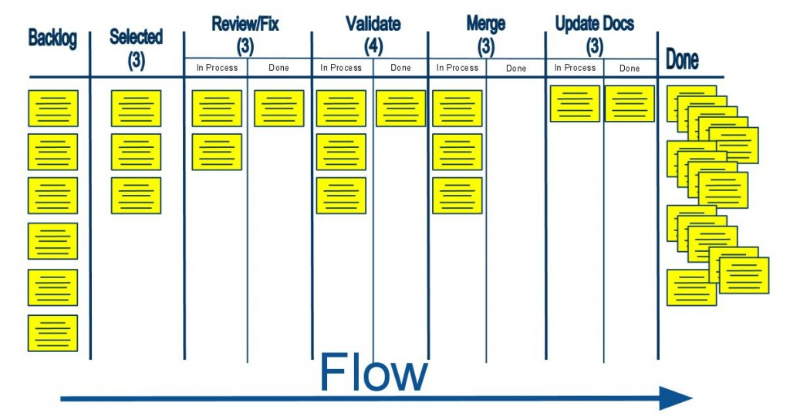
Kanban Board
Introduction / Agile Project Management

Slide 92
Agile Methodologies- Scrum-ban
Introduction / Agile Project Management/ Agile Methodologies
Scrum-ban is a software production model based on Scrum and Kanban
Scrum-ban is especially suited for maintenance projects or (system) projects with frequent and unexpected user stories or programming errors. Thus time-limited sprints of the Scrum model are of no appreciable use.
Scrum's daily meetings and other practices are highly useful
Visualization of the work stages⁽¹⁾ and limitations for simultaneous unfinished user stories⁽²⁾ and defects⁽³⁾ are part of the Kanban model.
The team's workflow is directed in a way that allows for minimum completion time for each user story or programming error, and on the other hand ensures each team member is constantly engaged.

Slide 93
Agile Methodologies- Crystal
Introduction / Agile Project Management/ Agile Methodologies
Crystal is one of the most light-weighted software development methodology
Crystal is a family of methodology. Family members are Crystal Clear, Crystal Yellow, Crystal Orange etc.
Which type of crystal methodology should be used for a particular project depends upon criticality of the project and number of people involved
This methodology relies on the fact the processes can be tailored based on unique characteristics of the project

Slide 94
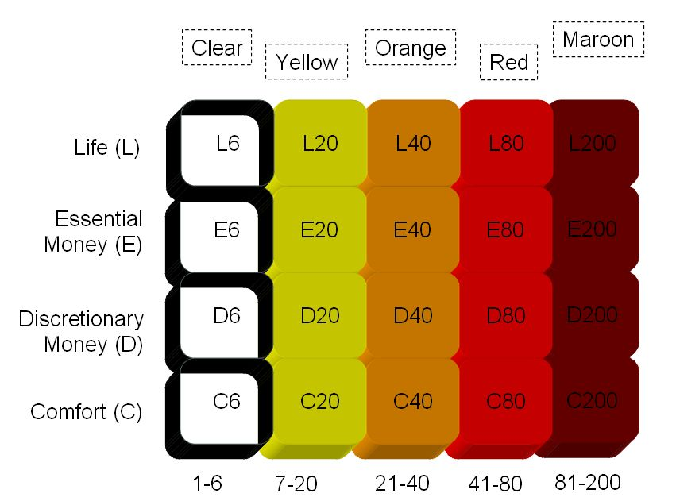
Agile Methodologies- Crystal
Introduction / Agile Project Management
Criticality, Defect cause ...
No of People Involved

Slide 95
When does Agile Methodologies Works Best?
When problems you are solving have following characteristics
Going to change while solving
Speed of development cannot be determined
Turbulence in environment
Customer doesn’t know how exactly it will look like

Slide 96
Agile Project Phases
Introduction / Agile Project Management
Envision : Determine the product vision, project scope, project community, how the will team work together
Speculate: Develop feature-based release, milestone, and iteration plan to deliver on the vision
Explore :
Deliver tested features in short timeframe, constantly seeking to reduce the risk of the project
Adapt :
Review the delivered results, the current situation, team’s performance and adapt as necessary
Close :
Conclude the project, pass along key learning and celebrate
At high level

Slide 97
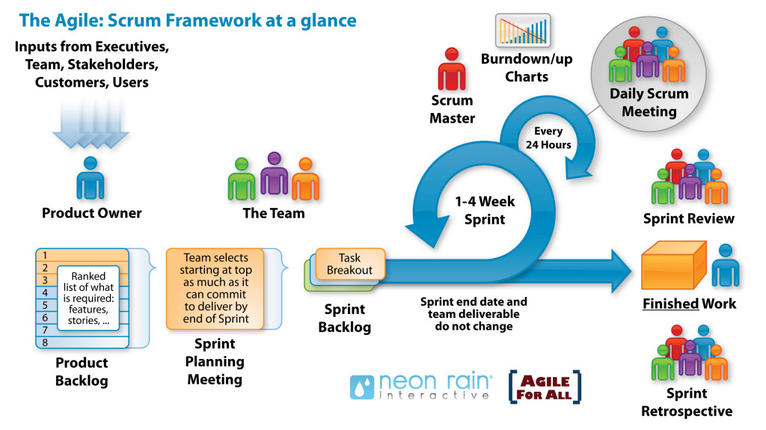
Agile Project Life-cycle
Introduction / Agile Project Management
Product Vision
Product Backlog
Project Kickoff
Release Planning
Inside Story

Slide 98
Value Delivery & Project Life Cycle
Introduction / Agile Project Management
Lifecycles: Waterfall- Iterative- Agile
Define
Design
Develop
Test
Deploy
Iteration-1
$
Phase1
Phase2
Phase3
Phase4
Phase5
Define
Design
Develop
Test
Deploy
$
Agile
Waterfall
Define
Design
Develop
Test
Deploy
Iteration-2
$
Define
Design
Develop
Test
Deploy
Iteration-3
$
Iterative
Define
Design
Develop
Define
Define
Define
Design
Design
Design
Develop
Develop
Develop
Test
Test
Test
Test
Deploy
Deploy
Deploy
Deploy
Iteration
Iteration1
Iteration2
Iteration3

Slide 99
PMBOK Processes vs Agile practices
Introduction / PMBOK Processes and Agile Practices Mapping
Integration Management
Develop Project Charter
Develop Project Management Plan
Direct and Manage Project Execution
Monitor & Control Project Work
Perform Integrated Change Control
Close Project or Phase
Agile Project Charter
Release and Iteration Planning
Iteration work
Regular Feedback and Collaboration
Prioritize Backlog and Implement Changes
Project Closure

Slide 100
PMBOK Processes vs Agile practices
Introduction / PMBOK Processes and Agile Practices Mapping
Scope Management
Collect Requirement
Define Scope
Create WBS
Verify Scope
Control Scope
Story writing & discussion
Technical spikes/ Sprint Backlog Planning
Feature Breakdown Structure (FBS)
Feature Acceptance Testing
Constant Feedback and Backlog Prioritization

Slide 101
PMBOK Processes vs Agile practices
Introduction / PMBOK Processes and Agile Practices Mapping
Time Management
Define Activities
Sequence Activities
Activity Resource Estimate
Activity Durations Estimates
Develop Schedule
Control Schedule
Sprint Planning
Sprint Planning
Velocity (Members signup)
Relative Size Estimation, Velocity
Sprint Planning
Temperature Reading and Adaptation

Slide 102
PMBOK Processes vs Agile practices
Introduction / PMBOK Processes and Agile Practices Mapping
Cost Management
Estimate Cost (bottom up)
Determine Budget
Control Cost
Estimate Cost (Top down)
Only for desired iteration
Collaboration, Backup update, retrospectives

Slide 103
PMBOK Processes vs Agile practices
Introduction / PMBOK Processes and Agile Practices Mapping
Quality Management
Plan Quality
Perform Quality Assurance
Perform Quality Control
Definition of “Done”
Peer review & Retrospectives
Continuous Integration, System Testing, Unit Testing

Slide 104
PMBOK Processes vs Agile practices
Introduction / PMBOK Processes and Agile Practices Mapping
Human Resource Management
Develop Human Resource Plan
Acquire Project Team
Develop Project Team
Manage Project Team
Release Planning, time boxed, feature driven planning
Dedicated team
Collaboration and cross-functional team
Self-organizing team, team based incentives

Slide 105
PMBOK Processes vs Agile practices
Introduction / PMBOK Processes and Agile Practices Mapping
Communication Management
Identify Stakeholders
Plan Communication
Distribute Information
Manage Stakeholder Expectations
Report Performance
Product owner and scrum master responsible
Agile framework
Information Radiators
Iteration Review
Iteration Review & Retrospective

Slide 106
PMBOK Processes vs Agile practices
Introduction / PMBOK Processes and Agile Practices Mapping
Risk Management
Plan Risk Management
Identify Risk
Perform Qualitative Risk Analysis
Perform Quantitative Risk Analysis
Plan Risk Response
Monitor & Control Risks
Iteration /Release Planning
Daily/ Iteration/ Release Planning, Stand-ups
Stand-ups & retrospectives
Not required
Stand-ups & retrospectives
Stand-ups & retrospectives, Information Radiators

Slide 107
PMBOK Processes vs Agile practices
Introduction / PMBOK Processes and Agile Practices Mapping
Procurement Management
Plan Procurement
Conduct Procurement
Administer Procurement
Control Procurement
Build in collaboration
Based on trust
Managing contracts in agile way
Staging or deliverables

Slide 108
Recap
Modern Project Management Challenges
How to address modern day PM challenges?
Challenges in Starting Agile Project Management
What is Agility?
Which Project Management Methodology is best?
Type of Systems
Complex Adaptive Systems (CAS)
Defined vs Empirical Processes
Values in Agile Manifesto
Agile Principles
Agile Methodologies
When Does Agile Methodologies Works Best?
Agile Project Lifecycle
Value Delivery & Project Life Cycle
Agile practices vs PMBoK Processes

Slide 110
Introduction: Agile Mindset

Slide 111
Topics
Introduction / Agile Mindset
Iteration
Incremental Delivery
Travel Light
Agile Product Building
Agile Documentation
Agile Architecture
Agile Testing
Last Responsible Moment
Refactoring
Technical Debt
Mindfulness
Energized Team
Poka Yoka
Agile Roles
Agile Health Checkup

Slide 112
Iteration / Sprint
Introduction / Agile Mindset
Agile project management relies on planning, developing and delivering product features in iterations
Iteration or sprint are time-boxed and duration can not changed from one iteration to another
Iteration is fixed time period in which team need to deliver some valuable product to customer
Prescription for duration length varies from one method to another in agile. In XP iteration length varies 1-3 week (typically one week), scrum and other methods it varies between 2-4 weeks (typically 4 weeks)
Iteration is also known as Sprint in Scrum Methodology

Slide 113
Incremental Delivery
Introduction / Agile Mindset
Delivering the complete product of a project in iterations. It helps in
Learning from previous iteration
Delivering high business value earlier
Adapt to change
Delivering more business value
Removing the waste by not doing those things which are not needed

Slide 114
Travel Light
Introduction / Agile Mindset
You need far less than what you think. Therefore carry on only those things which are most important and urgent.
YAGNI (You aren’t gonna need it)
TAGRI (They aren't gonna Read It)
This is different type of mountaineering. You may need to come back, you may need to change your path, trust that you will get stuff you need on the way etc factor exists here.

Slide 115
Agile Product Building
Introduction / Agile Mindset
Build complete product, all the time
One button should produce needed documentation, build the product executables, create installation materials, produce test results and tested components
Build should also work from command line
Everyone in team should use the same build process

Slide 116
Agile Documentation
Introduction / Agile Mindset
Maximize stakeholder investment. Produce document only when
It is needed by a stakeholder
Needed to define contract model
You need to think something in many iterations involving multiple groups
It is needed for external communication
Document only those things which are least likely to change
First identify the specific customer of the document
The document facilitates in estimating
Sufficiently index, details, accurate and consistent

Slide 117
Agile Documentation
Introduction / Agile Mindset
Strategies for reducing documentation CRUFT
C- How correct is document?
R- Will document be read?
U- Will document be understood?
F- Will document be followed?
T- Will document be trusted?

Slide 118
Agile Architecture
Introduction / Agile Mindset
Do the simplest thing possible which makes future changes/additions easier
No up-front high-level system architecture
No up-front high-level component architecture
No up-front high-level data model
Determine the details of technology when building functionality

Slide 119
Agile Testing
Introduction / Agile Mindset
All code must have test cases, ideally they should be created earlier
Unit tests should be executed during automated build
A build should be performed many times a time, ideally whenever anything is checked-in or committed to configuration server
If anybody’s code causing crash he should be informed immediately and that person should fix that problem first
All unit test must pass before code can be released

Slide 120
Last Responsible Moments
Introduction / Agile Mindset
Delay the decisions till the moment you have option to exercise because after this point one important options may be eliminated
It helps you in delivering more value in less time by doing only those things which are of high priority
It reduces inventory carrying cost
Getting more information and making more informed decision at last moment

Slide 121
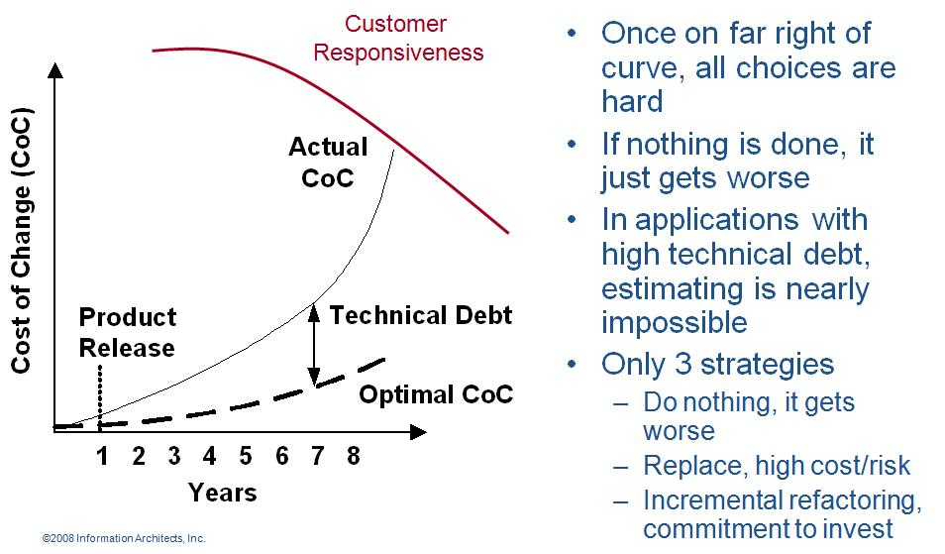
Refactoring
Introduction / Agile Mindset
Agile programmer writes simple and bare minimum code they do not complicate the code
Down the line structure the code without changing its behavior. It helps in improving the quality (maintainability, readability) of code

Slide 122
Technical Debt
Introduction / Agile Mindset
While writing code agile programmer do not pay attention to structure, duplication etc but to functionality and make sure that code is passing all unit test cases
In this process if they do not clean the code by structuring (refactoring) it will become unreadable and un-maintainable and over a period of time this cause increases response time to fix the problems, adding new feature and deteriorate the quality.
The concept of unclean code is called technical debt. Technical debt keep increasing over the period of time therefore Agile team need to pay this debt back by putting efforts in refactoring.

Slide 123
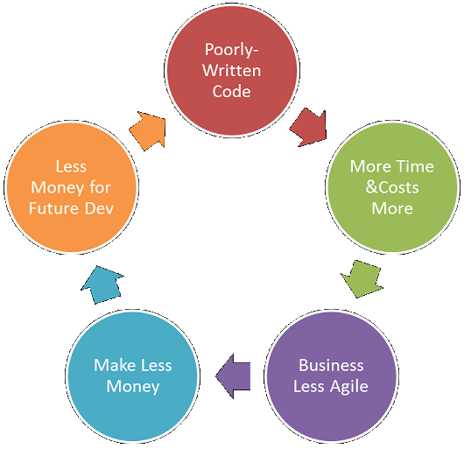
Technical Debt
Introduction / Agile Mindset
Vicious Cycle of Technical Debt

Slide 124
Mindfulness
Introduction / Agile Mindset
Agile team need to be conscious all the time, they need to keep observing patterns and proactively resolving the issues at root.
For example if they know that now it is taking more time to add even simple thing in existing code then it means time has come and they need to pay technical debt by refactoring

Slide 125
Energized Work
Introduction / Agile Mindset
Love your work: When you feel that I enjoy programming. I enjoy solving problems, writing good code, watching tests pass, and especially removing code while refactoring. I love to program in my spare time and sometimes even think about work in the shower. You love your work
Do not work overtime, enjoy balanced life, remain healthy, energetic and excited about work
When at work completely cut off from interruption like phone, email, IM etc. Pay 100% attention to work at hand
If you are making more mistake than progress then that is the time for break.

Slide 126
Poka Yoka
Mistake (Error) Proofing
Don't Accept a Defect
Don't Make a Defect
Don't Pass on a Defect
From Supplier
You
To Customer
Ideally, design the product so that it can't be assembled incorrectly
Error is deviation from process. Defect is in product who is deviating from specification or don’t meet customer expectations. Defect are introduced by errors

Slide 127
Agile Roles
Introduction / Agile Mindset
Pigs vs Chickens
Pigs are those roles which are committed
Chickens are those roles which are involved
Product Owner
Grooms product backlog, interface between product user and team
Prioritizes requirements based on value
Has authority to change requirement, reject product
Justify the importance of product and its features
Scrum Master
Process owner, ensures that stakeholders follow the processes
Removes impediments
Works as a servant leader
The Team
Includes architect, developer, tester, UI Desiger
Cross functional multi skilled team
Responsible for quality of the product

Slide 128
Agile Roles
Introduction / Agile Mindset
Agile Tester
Try to identify if a user does not do what he is suppose to do then what happens to the software? Report it.
Helps customer, product owner in writing acceptance test cases
Coach: Identify and Improve work habits
Interaction Designer: Learns and decides how users will interact with system.
SME (Domain Expert): Understands the business domain, regulatory requirements and defines business rule for the product

Slide 129
Agile Health Checkup
Introduction / Agile Mindset
To know the agile maturity in your project you can perform following Agile Health Checkup. Discuss in group and ask team to rate these parameters on the scale of 1-5
Frequent Delivery
Reflective Improvement
Close Communication (does it take less than 1 min to get you question answered by a person who know the answer?)
Focus (everybody understand the goal and desired outcome of the delivered software?)
Personal Safety (can you give bad news to your boss?)
Easy Access to Outside Experts
Strong Technical Environment (SVN used? Test Automation?)
Sunny Day Visibility (Does everyone on the team understand the rate of progress being made on the product?)
Regular Cadence or Rhythm (Is heartbeat of the system on?)

Slide 130
Recap
Introduction / Agile Project Management
Iteration
Incremental Delivery
Travel Light
Agile Product Building
Agile Documentation
Agile Architecture
Agile Testing
Last Responsible Moment
Refactoring
Technical Debt
Mindfulness
Energized Team
Poka Yoka
Agile Roles
Agile Health Checkup
Notes:
130

Slide 132
10 Tools & Techniques

Slide 133
10 Tools & Techniques
Communications
Planning, Monitoring, and Adapting
Agile Estimation
Metrics
Agile Analysis and Design
Product Quality
Interpersonal skills
Value-Based Prioritization
Process Improvement
Risk Management

Slide 134
Tools & Techniques Communication
Notes:
134

Slide 135
Most people do not listen with the intent to understand; they listen with the intent to reply.
“Seek first to understand, then to be understood.” – Steven R Covey

Slide 136
Topics
Tools & Techniques / Communication
Communication Management Plan
Team Space
Information Radiator
Osmotic Communication
Daily Stand-ups
Dimensions of Communications
Level of listening
Communication Skills
Communication Barriers
Communication Methods
Communication Model
Communication Technologies & Effectiveness
Collocated vs Distributed Team
Skills to Manage Stakeholders
Define Positive Values
Notes:
136

Slide 137
Communication Management Plan
Tools & Techniques / Communication
Identify who need to involved in communication
Identify what information they need, when and at what frequency
Identify how they want to be communicated
Understand why a particular information is required by a stakeholder, at a particular frequency, in a particular format
Understand the impact of not giving a particular information in desired format or frequency to a particular stakeholder
Important Note
Expand efforts in communicating only when providing information helps your project or not providing may cause some issue
Use appropriate technology for each communication need
Cost of communication is cost of communication technology, cost of time in making, sending, receiving, analyzing, responding queries etc.
Optimize your report format, frequency and communication cost by knowing number of communication channels. Channels= Nx(N-1)/2
Document the path of escalation for effective communication

Slide 138
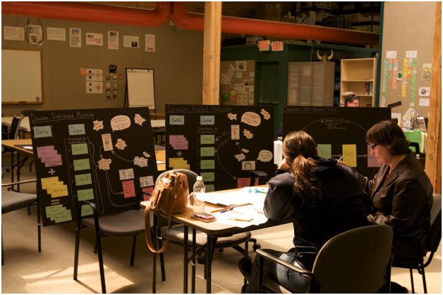
Team Space
Tools & Techniques / Communication
Team space is working area of agile project team. Only those people who are contributing to project directly should be allowed to sit, stay and talk in that area
This area should be
Informative
Spacious
Comfortable to work
Shielded from external noise
Easy to collaborate
Having expert in the same room where rest of the team is sitting is called “Expert in earshot”

Slide 139
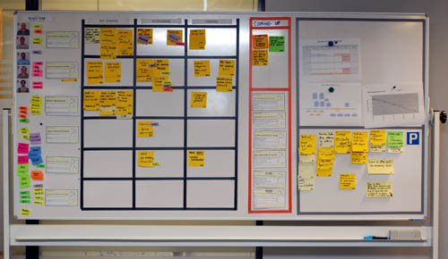
Information Radiator
Team Members
Work Progress
Impediments
Work Progress
Work Completed
Parking Lot

Slide 140
Osmotic Communication
Tools & Techniques / Communication
Agile project relies on collocation, minimum documentation, least reporting, maximum constructive engagement. This can be achieved if frequently sought important information is available in published form in team space
Whoever need the information can go and get the information without wasting time in requesting, making, sending, receiving the information
Benefits
Least cost, effort and time waste in communication
Updated information is always available without making new reports
People can get whatever particular information they are looking for
Happens at the same time
Feedback loop is quick
Those people who are left in regular reporting also get benefitted
No junk, old, repetitive information, but fresh and useful.
Dis-benefits
Some people get extra information which they do not need
It is left to individual’s interpretation

Slide 141
Daily Stand-ups
Tools & Techniques / Communication
Daily stand-up is heart beat of agile project management
Team meets daily (typically in working area, war room) at fixed time (time should not be changed) preferable first thing in morning
This is not reporting session but information sharing among team members
Only “Pigs” allowed to speak, “chicken” should listen (they are not allowed to interfere or ask while stand up meeting is in progress)
It is 15-20 min meeting, conducted while everybody is standing (showing the sense of urgency). A person should not take more than 2 min to update this work status.
Any one in the team can facilitate this meeting
Project manager notes the impediments and start working on those immediately after the meeting is over.

Slide 142
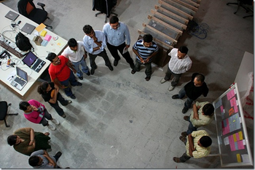
Daily Stand-ups
Tools & Techniques / Communication
3 Questions of standup meeting which every team member must address are
What did they do yesterday?
What are they planning to do today?
Any impediments on the way today?

Slide 143
Dimensions of Communications
Tools & Techniques / Communication
Internal vs External
Formal vs Informal
Vertical vs Horizontal
Official vs Unofficial
Written vs Oral
Verbal vs Non-verbal

Slide 144
Level of Listening
Level 1: Internal Listening (interpret in own language)
Level 2: Focused Listening (Responding without interpreting in own language)
Level 3: Focused but understand global environment (team, organization, customer etc)

Slide 145
Communication Skills
Tools & Techniques / Communication
Active Listening
Probing Ideas for Better Understanding
Fact Finding
Expectation Management
Conflict Resolution
Next Step Identification
Making Commitment
Contribute Effectively

Slide 146
Communication Barriers
Tools & Techniques / Communication
Physical Distance => Physical Proximity
Working in Different Shifts => Temporal Proximity
Human Language
Technical Knowledge
Detrimental Attitude
Difference in Culture
Difference in Project Environment
Attitude, willingness => Amicability
Communication Channels

Slide 147
Communication Methods
Tools & Techniques / Communication
Push Communication
Pull Communication
Interactive Communication

Slide 148
Communication Model
Source
Encoding
Message
channel
Decoding
Receiver
Noise
Feedback

Slide 149
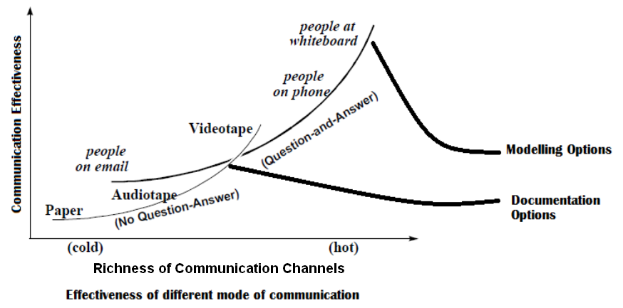
Communication Technologies & Effectiveness

Slide 150
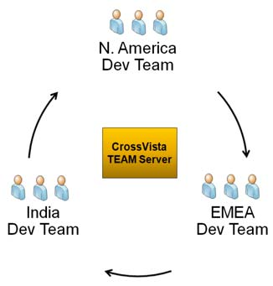
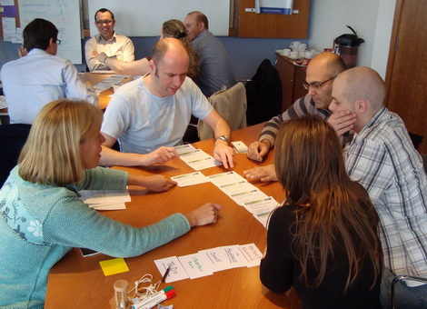
Collocated vs Distributed Team

Slide 151
Skills used to Manage Stakeholders
Tools & Techniques / Communication
Interpersonal Skills
Conflict Resolution
Active Listening
Trust Building
Influencing
Managerial Skills
Presentation
Public Speaking
Writing
Negotiation

Slide 152
Define Positive Values
Tools & Techniques / Communication
For effective communication we must understand values of various stakeholders. This is one of the major shift of management from Traditional to Agile Project Management
Understand and define values of
Customer
End user
Team
Organization
Sponsor

Slide 153
Define Positive Values
Tools & Techniques / Communication
Customer Values
Incremental Delivery
Client Driven
Client Focused
Adaption to Change
End user Values
Incremental Delivery
Waste Elimination
Prioritization
Quick Clarification
Team Values
Empowerment
Trust
Respect
Defining the work
Self-Organized
Future Leadership
Training
System Thinking
Organization Values
Least Escalations
Predictive Revenue
Simple Processes
Collaboration
New Business
No Extra Overhead
Sponsor Value
Predictive Demand
Predictive Revenue
Agile Accounting
Agile Contracting
Highest Return

Slide 154
Recap
Tools & Techniques / Communication
Communication Management Plan
Team Space
Information Radiator
Osmotic Communication
Daily Stand-ups
Dimensions of Communications
Level of listening
Communication Skills
Communication Barriers
Communication Methods
Communication Model
Communication Technologies & Effectiveness
Collocated vs Distributed Team
Skills to Manage Stakeholders
Define Positive Values
Notes:
154

Slide 156
10 Tools & Techniques
Communication
Planning, Monitoring & Adapting
Agile Estimation &
Metrics
Agile Analysis and Design
Product Quality
Soft Skills
Value Based Prioritization &
Value Stream Mapping
Risk Management

Slide 157
Tools & Techniques Planning, Monitoring & Adapting
Notes:
157

Slide 158
Failing to Plan is Planning to Fail
If you do not have your own plan then you are fitting in somebody else’s plan

Slide 159
Topics
Tools & Techniques / Planning, Monitoring & Adapting
Progressive Elaboration
Adaptive Planning
User Story
Types of User Stories
3Cs of User Story
INVEST Model of User Story
Epic, Feature, Story, Task
Agile Planning
Time-boxing
Minimum Marketable Features (MMF)
Agile Contracting Methods
Agile Project Tracking
Innovation Game
Notes:
159

Slide 160
Progressive Elaboration
Tools & Techniques / Planning, Monitoring & Adapting
Requirements in a project may not be known fully at the start of project. Because
Future requirements depends upon the results of earlier stages
It will be decided based on the reaction of market
Business conditions are too volatile so nothing can be predicted right now
Progressive elaboration relies on planning and executing only that work which is clearly known, has high priority and must be done in current period. Planning for remaining work can be done in future as and when detail requirements are known
School Management Application
Teacher Registration
Module
(1 Release of 3 Iteration; estimation possible because end user knows what exactly needed)
Student Registration
Module
(Complete requirements not available)
Some other N modules
Rolling wave planning means planning of one iteration at a time
Notes:
You have to develop one application for a university which has many campus and each campus offer multiple courses, each course involve multiple subject, a subject may have multiple professor, professor may be part time or visiting faculty. Requirements goes on and on. If you know what is the scope of work predictive planning makes sense but when all set of requirements are not know we should go for adaptive planning

Slide 161
Adaptive Planning
Tools & Techniques / Planning, Monitoring & Adapting
Adaptive planning is about incorporating lessons learned. Adjusting your future pace, processes, resources etc based on previous cycle of delivery.
Adaptive planning is required because what we want to develop may not be completely known or other factors like processes, tools, technologies, skills availability, business environment, market condition etc are not fully known or reliable and they all affect your planning.
It is complete opposite of predictive planning where everything is known at the time of planning.
In modern time it is extremely difficult to know about all the factors, which are affecting project success, in advance
Adaptive planning and empirical processes are the truth of 21st century! Days of definitive processes and predictive planning are not many.

Slide 162
User Story
Tools & Techniques / Planning, Monitoring & Adapting
A user story concept is kernel of Agile Project Management
A user story is work which a user want system to accomplish because it meets some of his objectives.
A user story is not functional specification document. It is a promise of product owner to the team that he will explain the requirements in details when the team is working on this
User story template
“As a user I want to accomplish something so that business value”
“There have been great societies that did not use the wheel, but there have been no societies that did not tell stories.” Unknown

Slide 163
Types of User Stories
Tools & Techniques / Planning, Monitoring & Adapting
Business user story
“As a class teacher I want to mark attendance of student so that we can issue them certificate”
Bug user story
“An error message is displayed whenever I try to save file in pdf format”
Technical user / Technical Spikes story
“Research a search component in .NET3.5 which is fit for our application”
Non-functional user story
“The Student Affairs Information System is up and running 99.9% during the registration time period defined in the Academic Calendar.”
Documentation user story
“Develop a user manual for teachers to use teacher module”

Slide 164
3Cs of User Story
Tools & Techniques / Planning, Monitoring & Adapting
Card
Conversation
Confirmation

Slide 165
INVEST Model of User Story
Tools & Techniques / Planning, Monitoring & Adapting
INVEST model defines following characteristics of a user story
Independent
Negotiable
Verifiable
Estimatable
Sized Appropriately
Testable

Slide 166
Epic, Feature, Story, Task
Tools & Techniques / Planning, Monitoring & Adapting
Epic is a collection of features. An epic is typically 1-3 months in duration
Feature is collection of stories. A feature is typically 2-4 weeks in duration
User-story is smallest unit of requirement created from features. A user-story is typically less than a week in duration
Task are smallest unit of executable items which team members assign to themselves to complete a user story. A task is typically of 8 hours in duration

Slide 167
Agile Planning
Tools & Techniques / Planning, Monitoring & Adapting
Agile project management does not rely on big bang planning rather it believes in level of planning.
Three level of planning in agile are
Release Planning
Iteration Planning
Daily Planning

Slide 168
Agile Planning
Tools & Techniques / Planning, Monitoring & Adapting
Release Planning
Creating a release plan is responsibility of product owner
If some user story cannot be estimated due to technical complexity then technical spikes are created
Typical length of a release varies between 3-6 months. For every month of work you can spend max one day for release planning. Thus 3 month release you can spend max 3 days.
Release planning should not be done without knowing velocity
It takes 3-4 uninterrupted iterations to benchmark velocity for a project team
Release planning depends upon
Deadline from competitor
Supporting the contract
To meet predetermined schedule
Supporting financial deadline
When there is enough value
To test the product
Two types of release plan
Scope-boxed release plan
Time-boxed release plan

Slide 169



Agile Planning
Tools & Techniques / Planning, Monitoring & Adapting
Release Planning
Product owner is ready with prioritized product backlog (prioritization is done based on business value)
Product owner defined release goals
During release planning product owner picks up only those user stories and features which helps him achieving release goals
All the selected user stories are pushed into release backlog
User stories in release backlog are size estimated using agile estimation techniques like story points
User stories in release backlog are again prioritized. It helps in creating number of iterations and iteration plan.

Slide 170
Agile Planning
Tools & Techniques / Planning, Monitoring & Adapting
Iteration/Sprint Planning
In iteration planning team identifies the task to be performed for each user story.
Task are pushed into iteration backlog
Iteration planning is held after retrospective meetings of last iteration
Typical iteration length varies from 1-4 weeks.
Iteration planning duration (1 hour for every week of iteration)
Iteration planning identifies iteration backlog items, assumptions, risks, actions, dependencies
Some team start counting iteration from zero so the initial iteration is called Sprint 0 or Iteration 0. In this iteration they take all technical spike which will help them in estimating size of complex user stories. Preparing initial architecture, solving infrastructure setup and configuration issues. Following Sprint 0 they start release planning
Tasks in iteration backlog are not assigned to any team member. Agile teams are self-organized and they pickup the task on their base.
Number of hours available in any iteration are calculated as Ideal engineering hours.

Slide 171
Agile Planning
Tools & Techniques / Planning, Monitoring & Adapting
Iteration Planning
Product owner defines Iteration Goal
User stories to be completed in an iteration is prioritized and selected by product owner. Agile team helps him in prioritizing technically related user stories.
Team picks selected user story and identifies task to be done in order to complete selected user story. All the identified tasked are pushed into Iteration Backlog. Mostly these will be programmer-centric tasks. Consider definition of “done”.
Effort estimate of each task is completed by team member using their experience
During planning team stop pushing tasks into iteration backlog when number of hours available for the iteration are exhausted

Slide 172
Agile Planning
Tools & Techniques / Planning, Monitoring & Adapting
Daily Planning
Immediately after or before daily standup meeting sessions and the team updates the kanban board.
This reflects the progress and planning of the day based on
The work progress of previous day
Any internal or external dependency not met
Something critical comes up
Client want to drop some user story

Slide 173
Time-boxing
Tools & Techniques / Planning, Monitoring & Adapting
Iteration length is time-boxed.
Following sequence of activities takes place in any time-boxed iteration
Grooming product backlog (done by product owner, in parallel to iteration work)
Iteration Planning (1 hour for every week of iteration)
Daily stand-up (15 min, max 2 min for one person, typical team size of agile team is 7±2)
Regular iteration work
Iteration Review (1 hour for every week of iteration)
Iteration Retrospective (1 hours for every week of iteration)

Slide 174
Minimum Marketable Features (MMF)
Tools & Techniques / Planning, Monitoring & Adapting
MMF is basic minimum set feature of the product so that people can start using it
MMF can be made of a single or combined of multiple user stories
MMF has business value to the end user

Slide 175
Agile Contracting Methods
Tools & Techniques / Planning, Monitoring & Adapting
Time & Material Contract
Most suitable contract type for agile project
Execution is driven by customer and they decide when a team member is required
Mutual trust is required in terms of skills provided to do the work and money will be provided for resource whether work is given by customer or not.
Fixed Price (FP) Contract
Most unsuitable for agile project which expects you to understand the full scope of work before you bid for the project
During execution customer need to help in prioritization while vendor may end up wasting efforts for nothing
FP can work in agile projects only
If customer should pay for every sprint
If provision to convert FP into T&M at any point of time is there
Provision to terminate by any party at any point of time is there

Slide 176
Agile Contracting Methods
Tools & Techniques / Planning, Monitoring & Adapting
Time & Material with Cap Contract
Customer can mention maximum number of people required in project and he can ask for those people at any point of time
Vendor need to ensure those resources are available on demand and have updated knowledge and skills to perform the work
Fixed Price (FP) Per Story Point
From vendor’s point of view this is better than fixed price
A method to calculate story point need to determined and agreed in advance because story point rate is agreed earlier than story point calculation
Fixed Price per Release
With respect to customer and vendor both this is better than FP and FP Per Story Point
Number of iteration in release should be defined upfront
Duration of each iteration need to defined earlier

Slide 177
Agile Project Tracking Tools & Techniques / Planning, Monitoring & Adapting/ Agile Project Tracking
Information Radiators
Self-assessment
Kanban Board
Cumulative Flow Diagram (CFD)
WIP Limit
Burn Charts
Retrospectives

Slide 178
Kanban Board
Tools & Techniques / Planning, Monitoring & Adapting/ Agile Project Tracking
After iteration planning is complete and before agile team starts working on task of the iteration, agile team need to pull the task from sprint backlog and put on kanban board
Kanban board has several columns. You can customize these columns based on your project characteristics. Typical columns are “User Story”, “To be done”, “Doing”, “Done”, ”Accepted”
You keep moving tasks from of any user story from left to right based on the progress. Finally when all the work is done all the cards will move under “Done” and user story will move user “Accepted” column

Slide 179
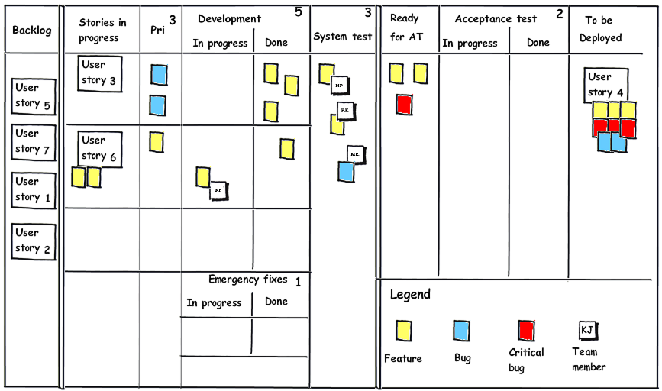
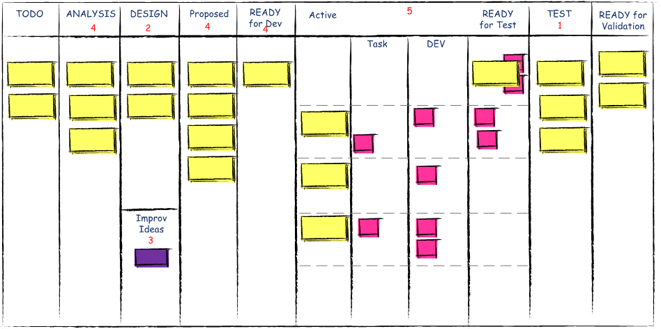
Kanban Board
Tools & Techniques / Planning, Monitoring & Adapting/ Agile Project Tracking
Story Kanban Board
Task Kanban Board

Slide 180
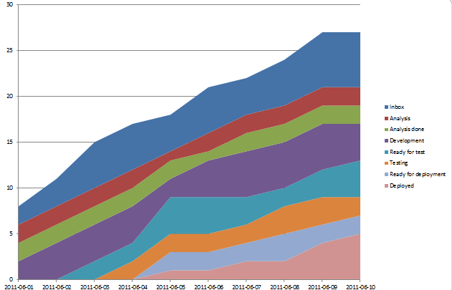
Cumulative Flow Diagram (CFD)
Tools & Techniques / Planning, Monitoring & Adapting/ Agile Project Tracking

Slide 181
WIP Limit
Tools & Techniques / Planning, Monitoring & Adapting
WIP limit is maximum number of work in progress items
In Kanban concept agile team should ensure that during execution at no point of time items in “in-progress” column should cross a defined WIP limit
“In-progress” work is treated as of no-value thus it is treated as waste. Therefore to maximize the value focus should be to convert WIP items into completed
Just-in-time (JIT) concept should be utilized to keep WIP limit smallest possible
Low WIP limit is also a challenge as it creates wastage of machine and workforce time

Slide 182
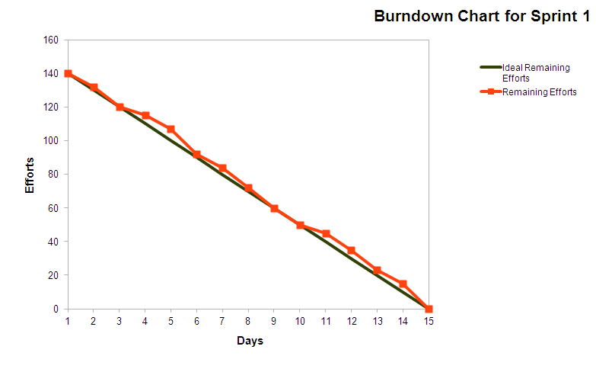
Burn Chart
Tools & Techniques / Planning, Monitoring & Adapting/ Agile Project Tracking
Burn Down Chart

Slide 183
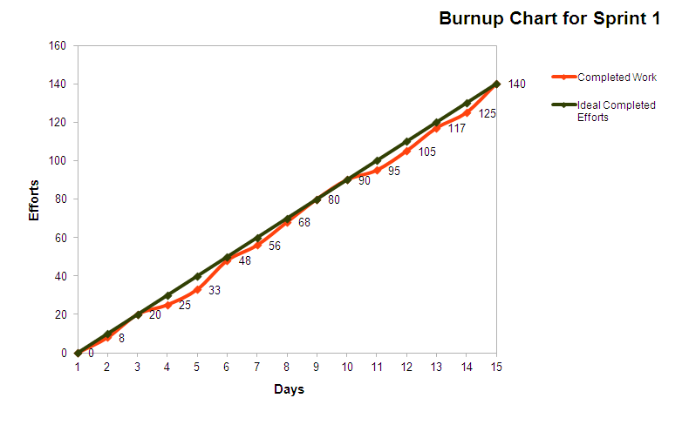
Burn Chart
Tools & Techniques / Planning, Monitoring & Adapting/ Agile Project Tracking
Burn Up Chart

Slide 184
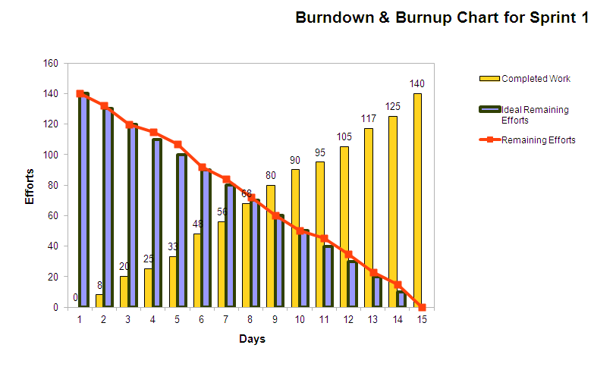
Burn chart
Tools & Techniques / Planning, Monitoring & Adapting/ Agile Project Tracking
Burn-down & Burn-up combine chart

Slide 185
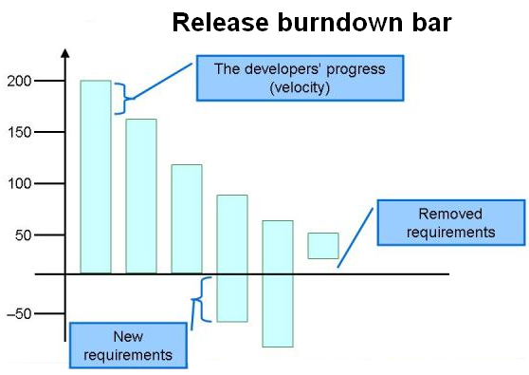
Burn Chart
Tools & Techniques / Planning, Monitoring & Adapting/ Agile Project Tracking
Burn Down Bar Chart
User Stories
Iteration1
Iteration2
Iteration3
Iteration4
Iteration5
Iteration 6

Slide 186
Innovation Game
Tools & Techniques / Planning, Monitoring & Adapting
Product development is innovative game therefore everybody need to contribute and play is role in the game with the spirit of game. It’s a game of cooperation and collaboration.
Things becomes boring in game when
You are doing same thing again and again without innovating some other method of doing work
People do not take action and they talk a lot
Only few people are participating and others are not getting involved
Therefore
Innovate the newness in the game
Innovate the new way of engagement
Do what you say
Must read book on Innovation Game: A book by Alistair Cockburn : Agile Software Development : The Cooperative Game

Slide 187
Recap
Tools & Techniques / Planning, Monitoring & Adapting
Progressive Elaboration
Adaptive Planning
User Story
Types of User Stories
3Cs of User Story
INVEST Model of User Story
Epic, Feature, Story, Task
Agile Planning
Time-boxing
Minimum Marketable Features (MMF)
Agile Contracting Methods
Agile Project Tracking
Innovation Game
Notes:
187

Slide 189
10 Tools & Techniques
Communications
Planning, Monitoring, and Adapting
Agile Estimation
Metrics
Agile Analysis and Design
Product Quality
Interpersonal skills
Value-Based Prioritization
Process Improvement
Risk Management

Slide 190
10 Different estimator gives 10 different estimates of the same piece of work, even one estimator gives 10 different estimates of the same work at 10 different times. Then what is the use of estimation?
Unknown

Slide 191
Tools & Techniques Agile Estimations & Metrics
Notes:
191

Slide 192
Topics
Tools & Techniques / Agile Estimating & Metrics
Size Estimation Techniques
Metrics
Cost Estimate
Basis of Estimation
Earn Value Management
S Curve
Notes:
192

Slide 193
Size Estimation Techniques Tools & Techniques / Agile Estimating & Metrics/ Size Estimation Techniques
Relative Sizing
Story Points
Wideband Delphi
Planning Poker
Affinity Estimation

Slide 194
Relative Sizing
Tools & Techniques / Agile Estimating & Metrics/ Size Estimation Techniques
We know at the start of project not enough detail is available to estimate the size of work. But high level requirements are available in the form of epic or module
Best way to estimate in this situation is relative sizing method
Based on current understanding of system and modules team picks up smallest size epic and then start comparing that with other modules.
Down the line at the time of release planning features or user stories are identified in epic and finer estimation is possible but again at this level preferred method of estimation is Relative Sizing
Hours, duration, cost based quantitative estimation makes sense only when you know the task to be done. But even for user story level estimation in release planning neither you have time not it is worth to identify task to do quantitative estimation
Notes:
194

Slide 195
Story Points
Tools & Techniques / Agile Estimating & Metrics/ Size Estimation Techniques
User story is the functionality of the system which has value in the eyes of customer
Count of user stories is called story points this is used to size user stories.
Because all stories are not same in efforts, complexity and risk therefore different methods are used to normalize this factor
Size is function of relative efforts, complexity and risk not of duration or IEH etc. Therefore when estimating size take away duration, number of people etc from your mind.
Some story point estimation methods are
T-shirt size – Story Point Estimation
Fibonacci Series – Story Point Estimation
Fruit size – Story Point Estimation
Notes:
195

Slide 196
Story Points
Tools & Techniques / Agile Estimating & Metrics/ Size Estimation Techniques
Let us say our product back log has
8 x bananas (5 points each) = 40 story points
10 x pineapple (20 points each) = 200 story points
6 x oranges (8 points each) = 48 story points
30 x bunches of grapes (2 points each) = 60 story points
Total story points in product backlog is 40+200+48+60 = 348
Les us assume that based on guess or some previous release teams knows that their velocity is 30 story points
Total iterations required = 348 / 30 = 11 iterations
If iteration is of 2 weeks then 22 weeks required to finish the work in product backlog

Slide 197
Wideband Delphi
Tools & Techniques / Agile Estimating & Metrics/ Size Estimation Techniques
Wideband Delphi is consensus based estimation method. A moderator facilitates the session.
Delphi technique keep names anonymous and helps avoiding biases and politics
Moderator reads and explains every feature to be estimated
All experts provides the estimates with basis of estimates. Estimates are provided anonymously
After first round of estimation is complete each items is discussed in group with all experts along with basis of estimates
In second round of discussion experts provides feedback after listening all basis of estimates and update these estimates
Notes:
197

Slide 198
Planning Poker
Tools & Techniques / Agile Estimating & Metrics/ Size Estimation Techniques
Planning poker is widely used estimation technique in agile projects. This is a variation of Wideband Delphi.
Logistic Required for Planning Poker Estimation
As many set of deck cards as many estimators in the room
All the team members with a deck of cards inside the room
A coordinator with laptop
A facilitator
Product owner
Planner Poker Process
Facilitator projects the product backlog on wall using a projector
He reads loudly a user story at a time so that everybody in the room understand what they need to estimate
Estimator estimates it silently and shows the card only to the coordinator
Coordinator documents all the estimates provided by all estimator
If there is difference between estimates then estimators who provided two extreme estimates need to talk the basis of estimates.
After a short discussion. Next round of estimation starts the same way as before and coordinator document the estimate provided by estimator
Keep repeating steps 3,4,5,6 till estimates provided by estimators are not converged
Read next user story
Notes:
198

Slide 199
Affinity Estimation
Tools & Techniques / Agile Estimating & Metrics/ Size Estimation Techniques
If product backlog has more than 20 items then implementing planning poker method of estimation is too much time consuming. In that case affinity estimation technique is most suitable
This helps in providing coarse estimates and good enough for release planning but for iteration planning you should use Planning Poker.
Logistics for Affinity Estimation
As may set of cards with printed user story. A story on a card.
A wide magnetic board with magnetic balls
All the team members inside the room
A coordinator with laptop
A facilitator
Product owner
Notes:
199

Slide 200
Affinity Estimation
Tools & Techniques / Agile Estimating & Metrics/ Size Estimation Techniques
Facilitator writes “smallest” at extreme left end of magnetic board and “largest” at extreme right of magnetic board
Set the ground rule of estimation session. Like it is mute session so we should not talk at all. All cards which are put on table need to be arranged on wall from left to right in terms of their relative size. You can shift position of cards from left to right or vice versa put by other member but without talking, convincing anybody, arguing or any kind of body language.
Estimators starts reading card and arranging them on the wall. If required they can discuss in private with product owner
If they are not able to understand any card ever after discussion with product owner they can move the card into Questionable column
After the session is over they need to group these cards in 5 or more groups like smallest, minor, medium, larger, largest
Coordinator need to type all these estimates into computer and share with project manager

Slide 201
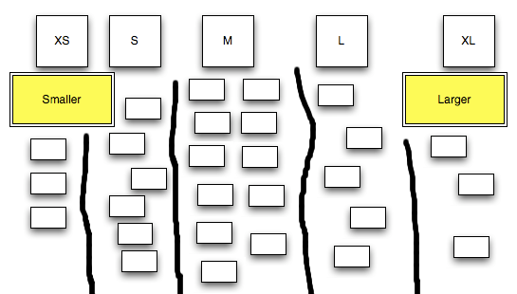
Affinity Estimation

Slide 202
Metrics Tools & Techniques / Agile Estimating & Metrics/ Metrics
Velocity
Lead Time
Cycle Time
Ideal Time
Escaped Defects
Project Scheduled
Features & Value Delivered
Delivery Performance
Product and Technical Quality Assessment

Slide 203
Metrics
Tools & Techniques / Agile Estimating & Metrics/ Metrics
Velocity
Velocity is number of story a team can do in an iteration.
When you are starting a new project that point of time best way to know the productivity is guess based on previous experience. But never benchmark velocity of team based on previous project
It takes 3-4 iteration to stabilize velocity of team
Team members should not be added or removed from development team otherwise it destabilized the velocity
Methods to improve velocity
Periodically pay down technical debt
Improve customer involvement
Support energized work environment
Provided needed resources (people, equipment, software etc)
Offload admin duties of programmer
Add experienced programmers
Notes:
203

Slide 204
Metrics
Tools & Techniques / Agile Estimating & Metrics/ Metrics
Lead Time (LT)
Lead time is the time required to deliver a given amount of work.
eg. Lead time to make tea is 15 min. From the time order is placed till the time tea is on table.

Slide 205
Metrics
Tools & Techniques / Agile Estimating & Metrics/ Metrics
Cycle Time (CT) & Throughput
Cycle Time is actually a measure of Throughput
Cycle Time = 1/ Throughput
Throughput is measured as units /period of time
Cycle Time is measured as amount of time/unit.
Example : At a tea stall for preparing a tea
Cycle Time = 2 minutes/ cup of tea
Throughput = 30 cups / hours
Notes:
205

Slide 206
Metrics
Relationship Between CT, LT and WIP
Lead Time = Cycle Time * WIP or
Lead Time = WIP/Throughput

Slide 207
Metrics
Kanban does not have concept of iteration and thus it does not talk about bunch of user stories in that iteration.
Kanban deal with individual user stories (it may be bug user story) and tracks the time to complete that user story. Thus the concept of Cycle Time and Throughput and WIP is important here.

Slide 208
Metrics
Tools & Techniques / Agile Estimating & Metrics/ Metrics
Ideal Time
Case Study:
Suppose a project where 5 team members are working starts on 1-Jan (Monday) and Finishes on 31-Jan. Company working times are from 8.00 am to 12.00pm and 12.00pm to 17.00pm. Company working days are Mon to Fri. In this period, there are two state holidays falling on organization working days.
How much is elapsed time of this project?
How much is duration of this project?
How much is effort required (actual effort) to complete the project?
How much is Ideal time in the project?
How any Ideal Engineering Hours (IEH) in the project?
Notes:
208

Slide 209
Metrics
Tools & Techniques / Agile Estimating & Metrics/ Metrics
Ideal Time
How much is elapsed time of this project?
31 Days
How much is duration of this project?
31-8 (4 week ends) – 2 (holidays)= 21 Days = 168 Hours
How much is effort required (planned effort) to complete the project?
21 days X 5 people X 8 hours =840 Hours
How much is Ideal time in the project?
Ideal time excludes the time of meetings, emails, peer review, phone calls, training, being pulled off to another work, task switching, tea breaks, lunch breaks, smoke break, biological break etc.
Excluding lunch and tea breaks a company typically has 8 working hours will not have more than 80% ideal time. That is ideal time on any day is 6.4 hours (max)
Thus ideal time for above project is 21 days X 6.4 hours = 135 hours
Ideal Engineering Hours (IEH)
If all 5 people on project are working individually (i.e. no peer review etc) then IEH = Ideal time * No of People = 675 hours

Slide 210
Metrics
Tools & Techniques / Agile Estimating & Metrics/ Metrics
Escaped Defects
In Agile escaped defects mean those defects which are leaked to next iteration or sprint.
Escaped Defect Rate = Total number of weighted defects for a sprint / number of total stories delivered in that sprint
Tracking the trend of this metrics helps you understanding the quality of product and maturity of testing process
Notes:
210

Slide 211
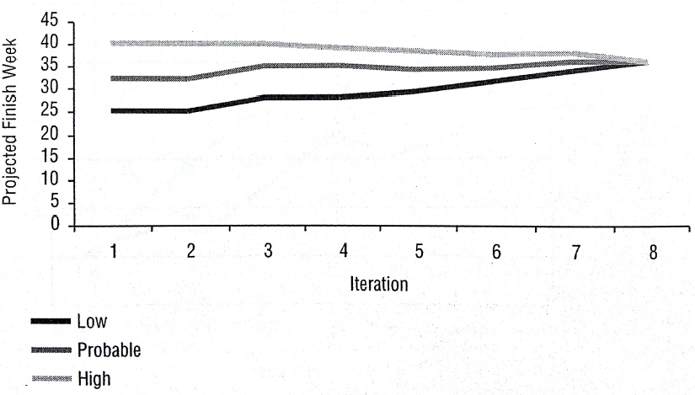
Metrics
Tools & Techniques / Agile Estimating & Metrics/ Metrics
Projected Scheduled
With x probability how much time is required to complete the project. Track this information for every iteration

Slide 212
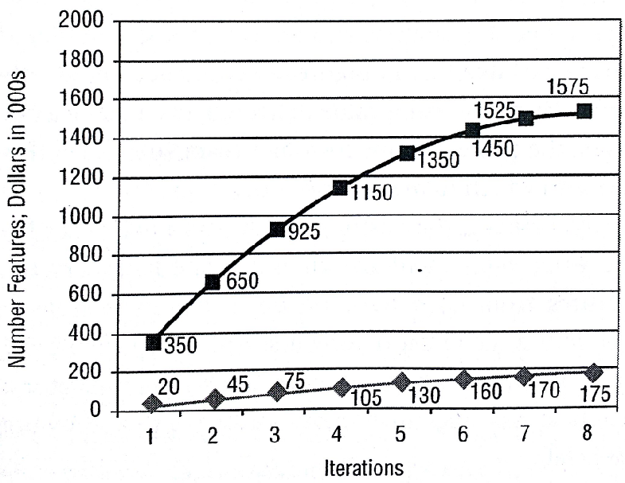
Metrics
Tools & Techniques / Agile Estimating & Metrics/ Metrics
Features & Value Delivered

Slide 213
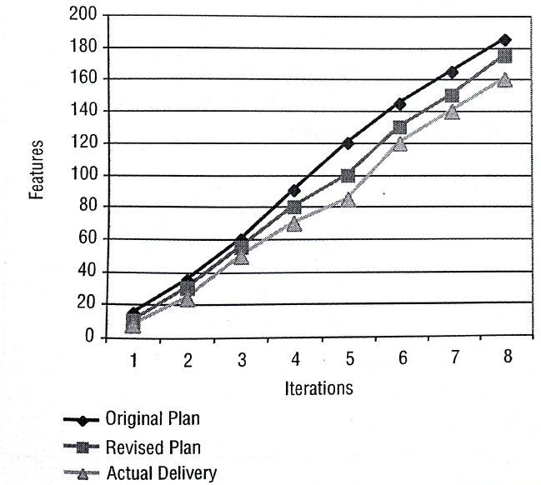
Metrics
Tools & Techniques / Agile Estimating & Metrics/ Metrics
Delivery Performance

Slide 214
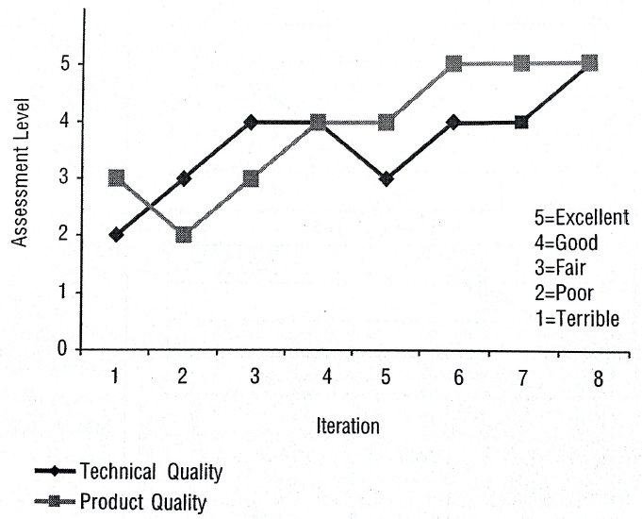
Metrics
Tools & Techniques / Agile Estimating & Metrics/ Metrics
Product and Technical Quality Assessment

Slide 215
Cost Estimate
Tools & Techniques / Agile Estimating & Metrics
Cost estimate for any release or iteration implies cost of all the resources used delivering user stories of the release or iteration.
Cost of resource includes cost of service used from vendor, cost of human resources, cost of software/hardware used, cost of training, cost of expenses like travelling, communication etc.
Opportunity cost is economic cost.
Notes:
215

Slide 216
Cost Estimate
Tools & Techniques / Agile Estimating & Metrics
Methods of estimations
Analogous Estimating
Parametric Estimating
Bottom-up Estimating
Vendor-bid Analysis
Reserve Analysis
Cost of Quality
Type of cost estimates (range names)
Order of magnitude (-25% to +75%)
Budgetary (-10% to +25%)
Definitive (-5% to +10%)
Notes:
216

Slide 217
Basis of Estimation
Tools & Techniques / Agile Estimating & Metrics
Estimates are never absolute. There are certain assumptions related to productivity, dependency, complexity, resource availability, resource rates etc which dictates the efforts, cost, duration and quality of the product of project
Basis of estimation helps you determining the range
Notes:
217

Slide 218
Earn Value Management
Tools & Techniques / Agile Estimating & Metrics
Earned value in Agile can be calculated using story point, efforts, cost. Being a time-boxed methodology time does not change
Lets us assume that product owner has planned one product
Release with three iteration and each iteration is of 2 weeks.
IEH in first, second and third iteration is 60, 60, 80 (adding resources) respectably (total 200 IEH).
Story points of user stories to be completed in this release is 30 SP.
Note: Although this approach is detrimental to agile because agile project management does not allow product owner to decide IEH to complete the stories he selected to complete in the release. But lets us assume that after some iterations of working team has stabilized the velocity and this velocity factor helps them determining IEH required to complete the release. Based on the velocity team feels confident to complete 30SP in 200 IEH. Lets assume iteration is complete and we are calculating EVM
*IEH is Ideal Engineering Hours
Notes:
218

Slide 219
Earn Value Management
Tools & Techniques / Agile Estimating & Metrics
Case 1 –Story Point based EVM
BAC- Total Story Points in current release = 30
PV- Planned story points to be completed at the end of 1st Iteration = 8
AC- Completed story point =7
ETC- More story to be completed in future iterations = 24
EV = BAC – ETC =6
Case2- Efforts based EVM
BAC- Planned efforts for current release = 200 IEH
PV- Planned efforts for the of 1st iteration = 60 IEH
AC- Actual efforts at the end of 1st iteration = 60 IEH (Agile does not encourage over time)
ETC- Efforts required to complete remaining story points = 120 IEH
EV- Budgeted efforts for the completed user stories = BAC – ETC = 80 IEH
If you know the cost of resources you can calculate EVM based on cost also

Slide 220
Earn Value Management
Tools & Techniques / Agile Estimating & Metrics
CV = EV- AC
CPI = EV/ AC
SV = EV –PV
SPI = EV/PV
EV = BAC - ETC
EAC = AC + ETC
EAC = BAC / ETC
EAC = BAC / (SPI * CPI)
VAC = BAC –EAC
TCPI = (BAC-EV) / (EAC-AC)

Slide 221
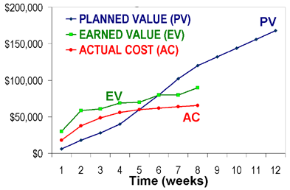
S Curve
Tools & Techniques / Agile Estimating & Metrics
Notes:
221

Slide 222
Recap
Tools & Techniques / Agile Estimating & Metrics
Size Estimation Techniques
Metrics
Cost Estimate
Basis of Estimation
Earn Value Management
S Curve
Notes:
222

Slide 224
10 Tools & Techniques
Communications
Planning, Monitoring, and Adapting
Agile Estimation
Metrics
Agile Analysis and Design
Product Quality
Interpersonal skills
Value-Based Prioritization
Process Improvement
Risk Management

Slide 225
Tools & Techniques Agile Analysis & Design
Notes:
225

Slide 226
Never ever be intellectual slave of any one, even of your parents, gurus, scripture and God. Develop sense of discrimination and use your analytical, logical capabilities.
Sri Adi Sankarcharya

Slide 227
Topics
Tools & Techniques / Agile Analysis & Design
Product Roadmap
Backlogs
Product
Release
Sprint
Story Maps
Requirement Collection and Validation
Agile Modeling
Prototype
Wireframes
Personas
Agile Design Principles
Agile Chartering
Notes:
227

Slide 228
Product Roadmap
Tools & Techniques / Agile Analysis & Design
A product roadmap is a plan where the features are planned for release on a timescale
It talks about business value addition to the customer by each release
Date, features and objective of each release
Overall product features (product backlog and business story)
Technical backlog (non-functional requirements, technical story)
Notes:
228

Slide 229
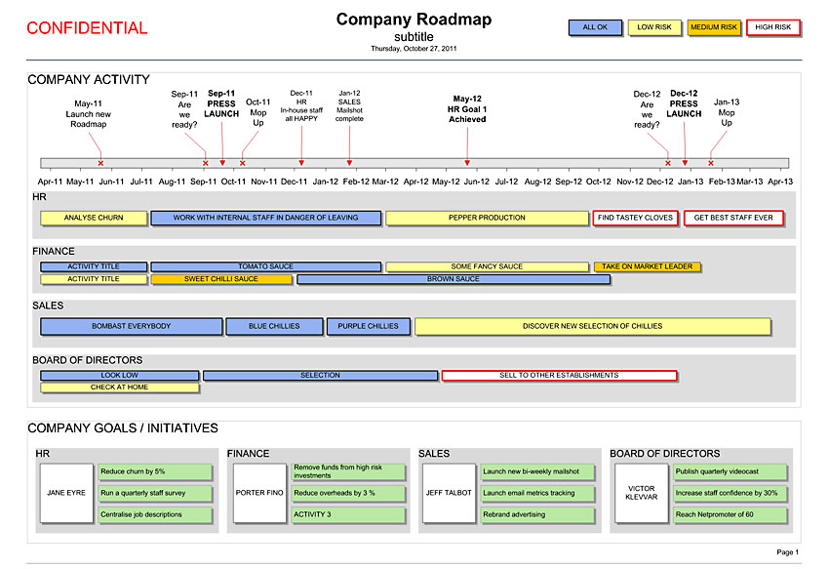
Product Roadmap
Tools & Techniques / Agile Analysis & Design

Slide 230
Backlogs Tools & Techniques / Agile Analysis & Design/ Backlog
Product Backlog
Release Backlog
Sprint Backlog
Notes:
230

Slide 231
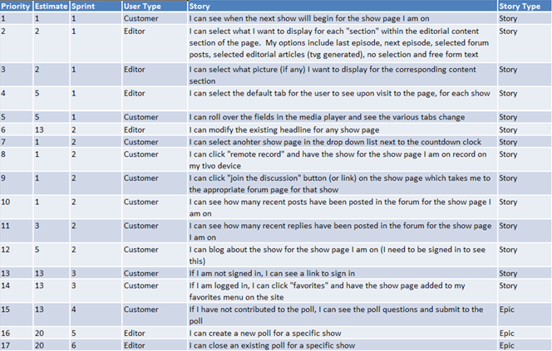
Backlog
Tools & Techniques / Agile Analysis & Design/ Backlog
Product Backlog
Product backlog grooming is continuous activity. PO is responsible for this.

Slide 232
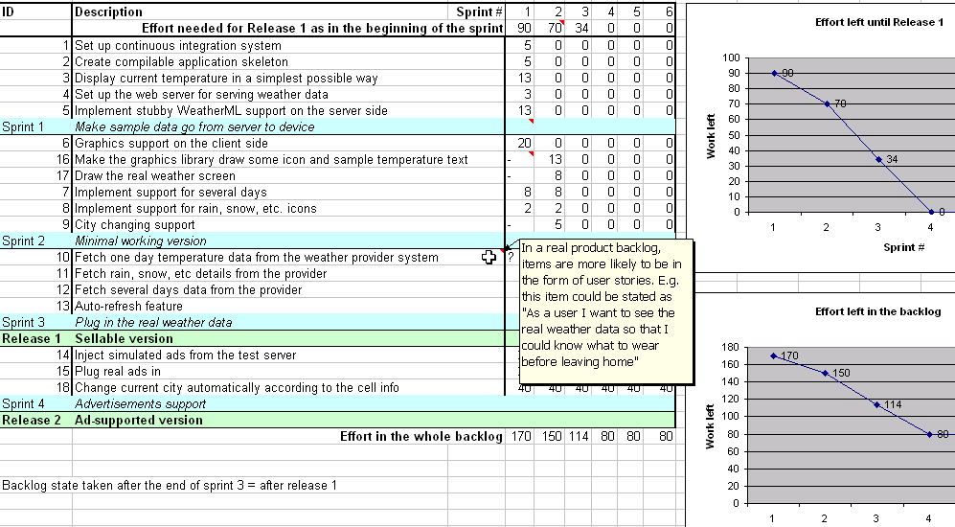
Backlog
Tools & Techniques / Agile Analysis & Design/ Backlog
Release Backlog
Release backlog is created during release planning meetings. PO is responsible for this

Slide 233
Backlog
Tools & Techniques / Agile Analysis & Design/ Backlog
Sprint Backlog
Unlike product backlog and release backlog which is comprised by user stories, sprint backlog is comprised of task
Sprint Backlog can have following types of tasks
Design Tasks
Coding Tasks
Testing Task
Documentation Tasks
No one is allowed to add user story or task in Sprint backlog but team can delete task if they feel out of time
Sprint backlog is developed at the time of sprint planning

Slide 234
Backlog
Tools & Techniques / Agile Analysis & Design/ Backlog
Sprint Backlog
Generally every task in sprint backlog should be related to some user story
To identify task for user story programmers need to do the detail discussion about user story with PO
Each task in sprint back log should have following information in the form of Task card
Task description
Estimated hours
Owner name (if taken by any team member)
Exit criteria
Verification method (test or inspection)
Who will perform verification

Slide 235
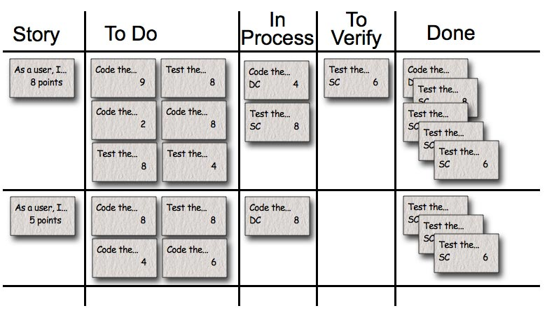
Backlog
Tools & Techniques / Agile Analysis & Design/ Backlog
Sprint Backlog

Slide 236
Story-maps
Tools & Techniques / Agile Analysis & Design
The main purpose of story mapping is to understand the end-to-end user requirements and stitch them in a logical thread so that users get maximum return on the business value
Benefits of Story-maps
Overall workflow of the system help in understanding value chain.
Relationship between large stories and child stories get established
Completeness of backlog can be validated
A basis of prioritization
Helps in release planning
Notes:
236

Slide 237
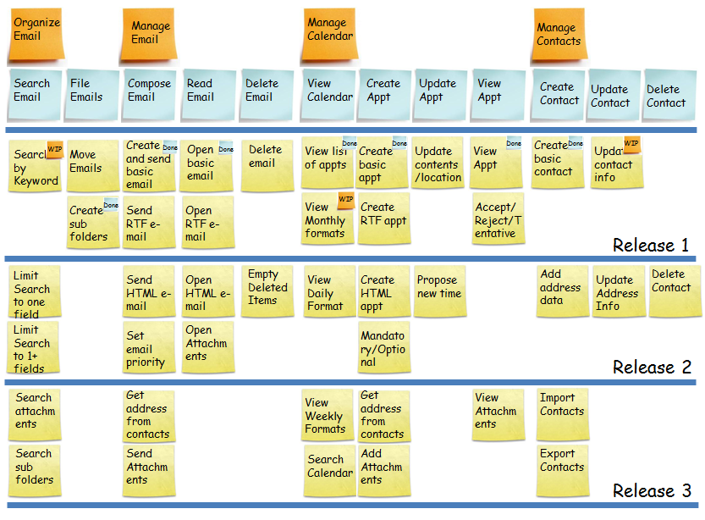
Storymaps
Tools & Techniques / Agile Analysis & Design
Notes:
237

Slide 238
Requirement Collection and Validation
Tools & Techniques / Agile Analysis & Design
Interviews
Focus Group
Facilitated Workshop
Notes:
238

Slide 239
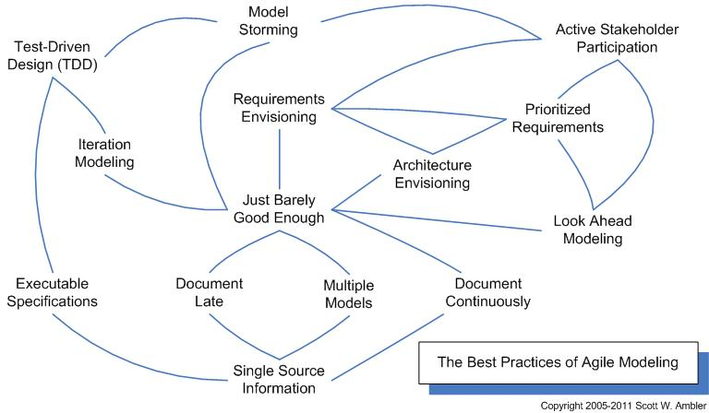
Agile Modeling
Tools & Techniques / Agile Analysis & Design
Agile Modeling (AM) is a practice-based methodology for effective modeling and documentation of software-based systems.
At a high level AM is a collection of best practices, depicted in the pattern language map below.
At a more detailed level AM is a collection of values, principles, and practices for modeling software that can be applied on a software development project in an effective and light-weight manner.
Notes:
239

Slide 240
Agile Modeling
Tools & Techniques / Agile Analysis & Design
Agile requirement modeling techniques
Active Stakeholder Participation
Electronic Interviews
Face-to-Face Interviews
Focus Groups
Joint Application Design (JAD)
Legacy Code Analysis
Observation
On-Site Customer
Reading

Slide 241
Agile Modeling
Tools & Techniques / Agile Analysis & Design
Artifacts of Analysis Modeling
Activity Diagram
Class Diagram
Constraint definition
CRC model
Data flow diagram (DFD)
Entity/Relationship (E/R) diagram (data diagram)
Flow chart
Robustness diagrams
Sequence diagram
State chart diagram
System use case
UI prototype
Usage scenario
Use case diagram

Slide 242
Agile Modeling
Tools & Techniques / Agile Analysis & Design
List of important Modeling which you may need to perform in Agile. Either you use some software for these or use plain word/excel/powerpoint or just draw them on white board.
Acceptance Test
Business Rule
Change Case
Class Responsibility Collaborator (CRC) model
Constraint
Contract model
Data Flow Diagram (DFD)
Domain Model
Essential/Abstract Use Case
Essential/Abstract User Interface Prototype
Feature

Slide 243
Agile Modeling
Tools & Techniques / Agile Analysis & Design
Free-Form Diagrams
Flow Chart
Glossary
Logical Data Model (LDM)
Network Diagram
Object Role Model (ORM) Diagram
Personas
Physical Data Model (PDM)
Robustness Diagram
Security Threat Model
System Use Case
Technical Requirement
Usage Scenario
User Interface Flow Diagram (Storyboard)

Slide 244
Agile Modeling
Tools & Techniques / Agile Analysis & Design
User Interface Prototype
User Story
Value Stream Map
UML 2 Activity Diagram
UML 2 Class Diagram
UML 2 Communication/Collaboration Diagram
UML 2 Component Diagram
UML 2 Composite Structure Diagram
UML 2 Deployment Diagram
UML 2 Interaction Overview Diagram
UML 2 Object Diagram
UML 2 Package Diagram
UML 2 Sequence Diagram
UML 2 State Machine Diagram
UML 2 Timing Diagram
UML 2 Use Case Diagram

Slide 245
Agile Design Principles
Tools & Techniques / Agile Analysis & Design
There are 5 principles of Agile design named as SOLID.
Single Responsibility Principle: A class should have only one reason to change
Open Closed Principle : Classes, modules and functions should be open for extension but closed for modification
Liskov Substitution Principle: Derived types must be completely substitutable for their base types.
Interface Segregation Principle: Client should not be forced to depend upon interfaces that they don’t use
Dependency Inversion Principle: High level modules should not depend on low level modules. Both should depend on abstractions. Abstractions should not depend on details. Details should depend on abstraction.

Slide 246
Agile Chartering
Tools & Techniques / Agile Analysis & Design
Agile chartering is done before Release Planning. The main purpose of the project chartering is to establish a vision, goal and high level requirements. Agile charter like traditional project charters establish
The purpose of project (why we are doing it)
What we want to achieve
Success criteria of project
Role of senior people engaging in the project
Notes:
246

Slide 247
Recap
Tools & Techniques / Agile Analysis & Design
Product Roadmap
Backlogs
Product
Release
Sprint
Story Maps
Requirement Collection and Validation
Agile Modeling
Prototype
Wireframes
Personas
Agile Design Principles
Agile Chartering
Notes:
247

Slide 249
10 Tools & Techniques
Communications
Planning, Monitoring, and Adapting
Agile Estimation
Metrics
Agile Analysis and Design
Product Quality
Interpersonal skills
Value-Based Prioritization
Process Improvement
Risk Management

Slide 250
Tools & Techniques Product Quality
Notes:
250

Slide 251
Quality means doing it right when no one is looking
Henry Ford
Quality is never an accident; it is always the result of high intention, sincere effort, intelligent direction and skillful execution; it represents the wise choice of many alternatives.
Unknown

Slide 252
Topics
Tools & Techniques / Product Quality
Cost of Quality
Definition of Done
Feedback Techniques of Agile Project Management
Verification and Validation
Test Driven Development (TDD)
Acceptance Test Driven Development (ATDD)
Exploratory Testing
Continuous Integration
Continuous Process Improvement
7 Wastes
House Keeping Standard (5S)
Version Control
Agile Tooling Mistake
Typical Software Tools in Agile Projects
Quality Tools
Notes:
252

Slide 253
Cost of Quality
Tools & Techniques / Product Quality
Cost of conformance
Appraisal Costs
checking & Testing Purchased Goods
In-process and Final Inspection Testing
Field Testing
Product, Process and Service Audits
Calibration of Measuring and Test Equipment
Prevention Costs
Capability Evaluation
Error Proofing
Quality Planning
New Product Review
Quality Improvement Project
Quality Education and Training
Supplier Evaluation
Cost of nonconformance
Internal Failure Costs
Re-design
Downtime
Re-testing
Shortages
Delays
Rework
Lack of flexibility
External Failure Costs
Environmental Costs
Loss due to Sales Reductions
Warranties
Repairing Goods
Complaints

Slide 254
Definition of Done (DoD)
Tools & Techniques / Product Quality
The DoD changes over time. Organizational support and the team’s ability to remove impediments may enable the inclusion of additional activities into the DoD for features or sprints.
Continuous Integration (CI) helps you validating the “Doneness”
There are 3 level of DoD
Story DoD
Iteration DoD
Release DoD

Slide 255
Definition of Done (DoD)
Tools & Techniques / Product Quality
Story “Done”
Unit test should provide 60-70% test coverage
Story is either written in pair or reviewed by peer
All code checked in
All unit code passed
All acceptance test case passed
Story accepted by owner

Slide 256
Definition of Done (DoD)
Iteration “Done”
Iteration should have defined Iteration Goal
All acceptance test cases should run for all user stories in Iteration
All stories completed must be accepted by the product owner
Defects identified are fixed or planned for future
Code performance is tested and accepted
If database is involved then database script should be available, automated and tested
Backup of iteration work product is taken

Slide 257
Definition of Done (DoD)
Release “Done”
Release should have defined Release Goal
Product has formal release date
Product is deployed on staging area
Stress testing done and results accepted
All non-functional requirements are tested and results accepted
Required documentation is available
Release should not have any known bug

Slide 258
Feedback Techniques of Agile Project Management
Tools & Techniques / Product Quality
Timely & regular feedback is heart beat for producing a good quality product and managing risks. Following techniques are used to get quick feedback.
Release planning
Sprint planning
Daily stand-up
Sprint review
Sprint retrospective
Pair programming
Peer review
Customer involvement throughout PLC

Slide 259
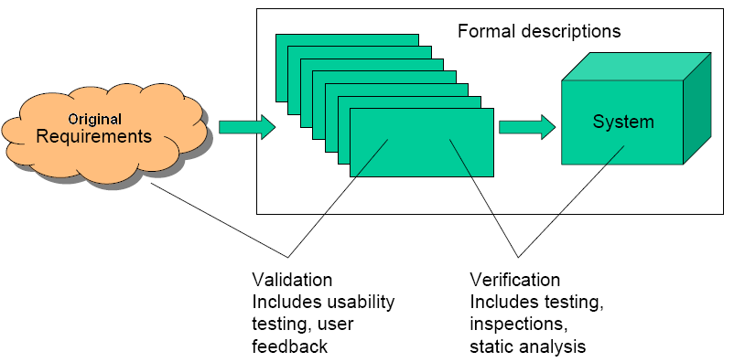
Verification and Validation
Tools & Techniques / Product Quality
Validation:
How close is Product with respect to original requirement
Building the right things
Verification:
How close is product built Process with respect to defined and agreed
Building the things right

Slide 260
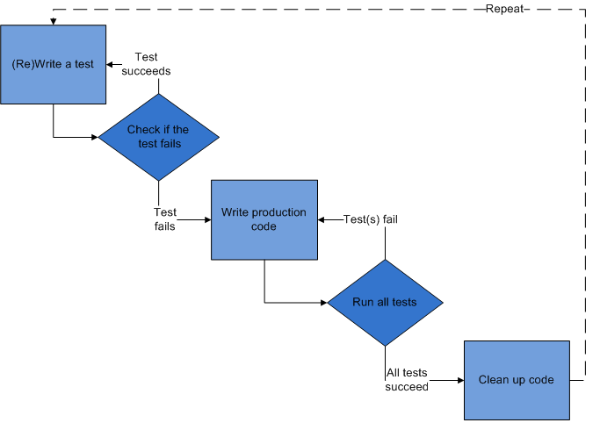
Test Driven Development (TDD)
Tools & Techniques / Product Quality
Programmer should not consider exception cases and error handling initially. Those can be considered in next cycle, once basic functionality is working.
If built passes unit test then only it is promoted to the next step as a candidate for acceptance test build

Slide 261
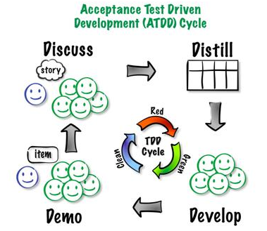
Acceptance Test Driven Development (ATDD)
Tools & Techniques / Product Quality
Major difference between ATDD and TDD is in ATDD user story or functionality is tested not the task like in TDD.
Using ATDD practice you are not allowed to add more functionality until earlier user stories are successful.
Collection of acceptance test cases forms regression test and it should run automatically on built server

Slide 262
Exploratory Testing
Tools & Techniques / Product Quality
After acceptance test cases are passed then Agile tester may choose to perform exploratory testing
In exploratory testing agile tester tests those scenario which system user is not supposed to perform but if he perform in that case system should give proper message.

Slide 263
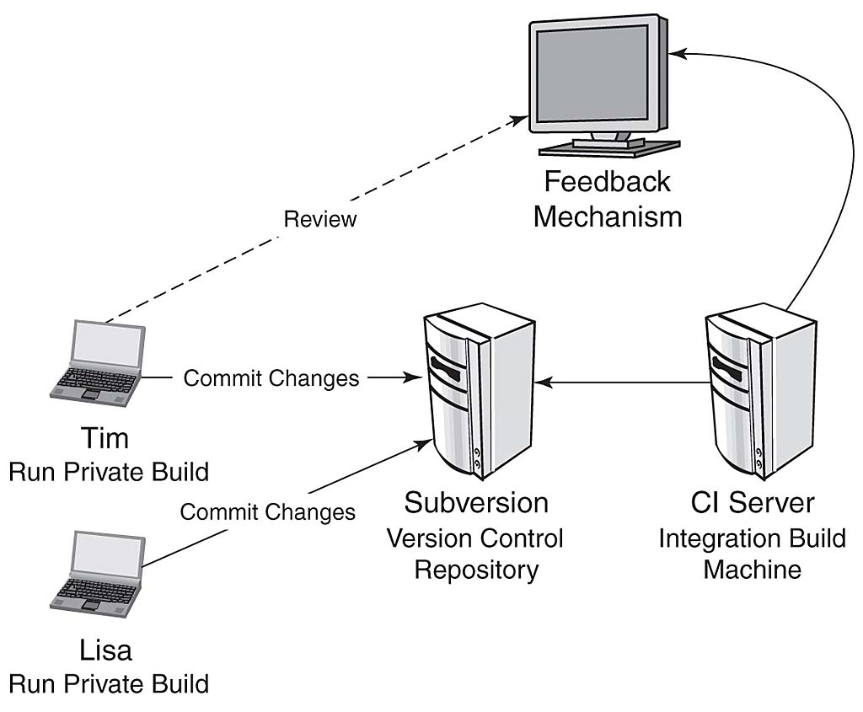
Continuous Integration
Tools & Techniques / Product Quality
Tool: CruiseControl for Java & .NET
Build should happen within 10 min, else change server
No partial build
Email to Lisa if any of her code breaks

Slide 264
Continuous Process Improvement
Tools & Techniques / Product Quality
Models for Continuous Process Improvement
PDCA Cycle (by Juran - “Fintness for Use”)
Score Card
Escaped defects, Overtime, Velocity, Cost, Time
Balance Score Card (BSC)
Four aspects of BSC are Financial, Customer, Internal Business Proceeds, Learning and Growth
Six Sigma (DMAIC)
Motorola in 1985
Used widely by Jack Welch @ GE in 1995
Kaizen
Eliminating the waste
Kanban

Slide 265
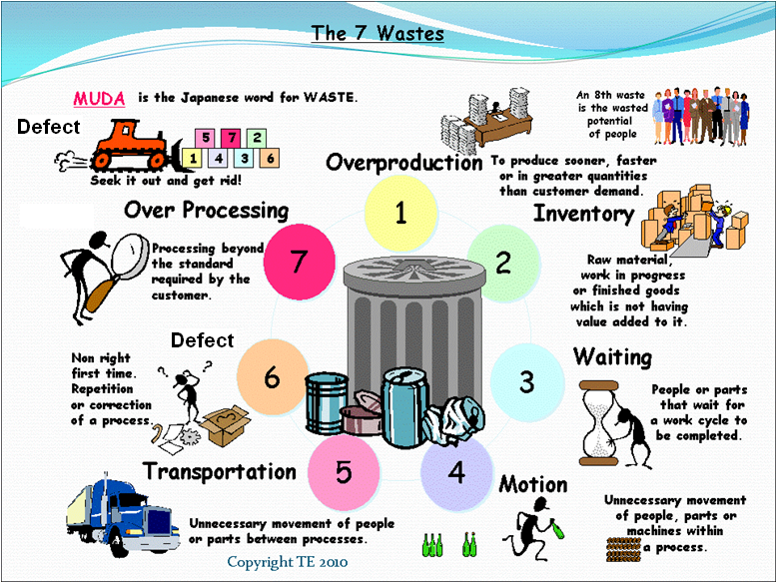
7 Wastes
Tools & Techniques / Product Quality
TIM WOOD

Slide 266
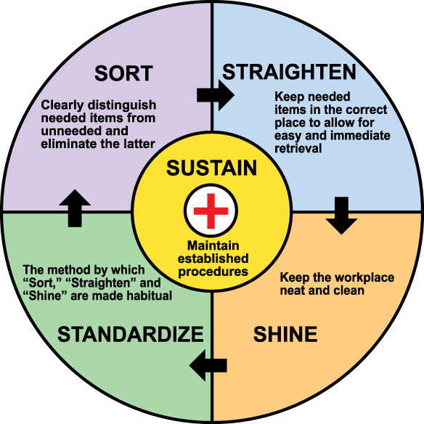
House Keeping Standard (5S)
Tools & Techniques / Product Quality
In Lean 5S is foundation tool for continuous improvement.
5S is also called house keeping standard because it lists down the steps to organize a work space for efficiency and effectiveness by identifying and storing the items used, maintaining the area and items, and sustaining the new order.

Slide 267
Version Control
Tools & Techniques / Product Quality
A version control system is a repository of files and source code, with monitored access. Every change made to the source is tracked, along with who made the change, why they made it, and references to problems fixed, or enhancements introduced, by the change. This is very important tool to ensure quality product.
Collective code ownership means whole team takes responsibility of the quality of the code therefore anybody can modify the code, if needed. (Encouraged in XP Agile Method)
Strong code ownership means each person owns his module. Only he can make changes to his module.
Weak Code Ownership means one person write the module but another person can make changes as long as owner helps them or they coordinate with owner
When two users can update the same code at same time is called Concurrent editing. Conflict is resolved using merging method.

Slide 268

Version Control
Don’t save change = Revert
Tools & Techniques / Product Quality
Label “Release A”
Checkout File “ABC”
Save change to repository =
Checkin or Commit
Sandbox
Repository
Remove tip from the repository
= RollBack
ver 1
ver 2
File “ABC” is locked
It can be updated
Merge
Branch
ver 1
ver 2
Tip or Head

Slide 269
Agile Tooling Mistake
Tools & Techniques / Product Quality
For producing a good quality product agile project management relies heavily on automation. Therefore not investing in tools or using legacy tools for agile project management affects the moral of the team and quality of the product
Generally following mistakes are made by organization in agile tooling
Using old version of tool which were working for waterfall
Not investing on automation tool still continuing manual testing, documentation etc
Working on age old slow hardware, while team is wasting time
Not investing time on continuous-integration tool
Using traditional waterfall metrics to manage the project
Performing continuous integration only on mainline not on branch so branch code becomes buggy and unreliable.

Slide 270
Typical Software Tools in Agile Projects
Tools & Techniques / Product Quality
Agile project management systems (APMS) for effective communication and providing bird’s eye view of the project
Rally, VersionOne, Jira
Testing Tools to achieve 100% code coverage by auto unit testing.
xUnit
Regression Testing Tool
CruiseControl, TFS
Version Control to mange versions of code, product, test-case, tested product
SVN, SourceSafe, TFS

Slide 271
Quality Tools Tools & Techniques / Product Quality/ Quality Tools
These tools are useful in quality planning, quality assurance, quality control and continuous improvement
Benchmarking
Control Charts
Affinity Diagram
Force Field Analysis
Quality Checklists
Cause and effect diagram
Pareto Charts
Histograms
Run Charts
Influence Diagram or Decision Network
SWOT Analysis
Design of Experiments (DOE)

Slide 272
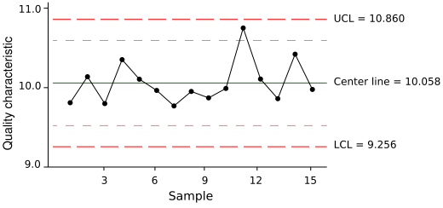
Quality Tools
Tools & Techniques / Product Quality/ Quality Tools
Control Chart

Slide 273
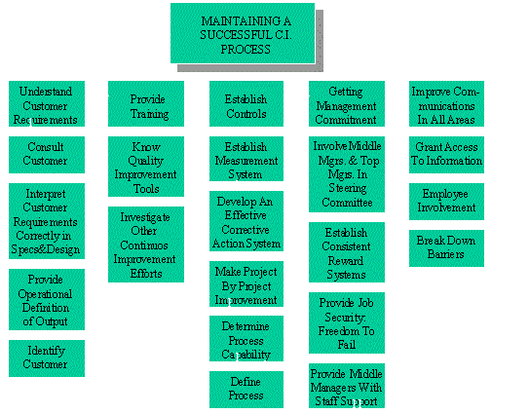
Quality Tools
Tools & Techniques / Product Quality/ Quality Tools
Affinity Diagram

Slide 274
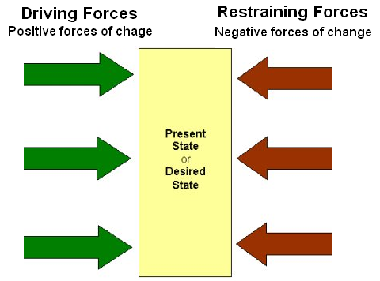
Quality Tools
Tools & Techniques / Product Quality/ Quality Tools
Force Field Analysis

Slide 275
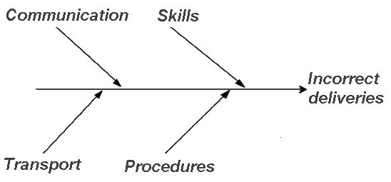
Quality Tools
Tools & Techniques / Product Quality/ Quality Tools
Cause and Effect Diagram

Slide 276

Quality Tools
Tools & Techniques / Product Quality/ Quality Tools
Pareto Chart

Slide 277

Quality Tools
Tools & Techniques / Product Quality/ Quality Tools
Influence Diagram

Slide 278
Recap
Tools & Techniques / Product Quality
Cost of Quality
Definition of Done
Feedback Techniques of Agile Project Management
Verification and Validation
Test Driven Development (TDD)
Acceptance Test Driven Development (ATDD)
Continuous Integration
Continuous Process Improvement
7 Wastes
House Keeping Standard (5S)
Version Control
Quality Tools
Notes:
278

Slide 280
10 Tools & Techniques
Communications
Planning, Monitoring, and Adapting
Agile Estimation
Metrics
Agile Analysis and Design
Product Quality
Interpersonal skills
Value-Based Prioritization
Process Improvement
Risk Management

Slide 281
Tools & Techniques Interpersonal Skills
Notes:
281

Slide 282
Education is not the piling on of learning, information, data, facts, skills, or abilities - that's training or instruction - but is rather making visible what is hidden as a seed

Slide 283
Topics
Tools & Techniques / Soft Skills
Emotional Intelligence
Self Organizing Team
Shu-Ha-Ri
Active Listening
Collaboration
Adaptive Leadership
Interpersonal Skills of a Project Manager
Negotiation Strategies
Type of Powers
Group Decision Making Techniques
Conflict Management
Team Management
Mentoring & Coaching Team
Learning and Working
BART Analysis
Team Self-Assessment Chart
Servant Leadership
Notes:
283

Slide 284

Emotional Intelligence
Tools & Techniques / Soft Skills
Emotional intelligence (EI) is the ability to identify, assess, and control the emotions of oneself, of others, and of groups
One of the value of agile project management is “Individuals and interactions over processes and tools”. Thus the project success heavily depends upon people management

Slide 285
Self Organizing Team
Tools & Techniques / Soft Skills
Agile team is a team of highly self motivated, organized, disciplined individuals. They manage complete project without any extra motives. The team has strong will to make project successful.
In all project activities like planning, execution, monitoring, adapting they participate willingly, and live with values and principles of Agile manifesto.
No work is assigned to agile team members but they identify the most important task to deliver maximum business value in planning sessions and picks up the task on their own while sprint work is on.
When the team was previously commanded and controlled, the general tendency is to wait for instructions than figuring out ourselves. This is anti-pattern of self-organizing team. It is very difficult to build a self organizing team under the same leadership, who used to command and control earlier

Slide 286
Shu-Ha-Ri
Tools & Techniques / Soft Skills
Shu-Ha-Ri is Japanese term according to this a student or team goes through three stages of learning. Whatever you teach them it takes time to master the art. Three stages are
Shu: This is the initial obedient stage, when the student just follows the rules.
Ha: The student questions the rules, understands their importance, and makes innovations within the rules.
Ri: The student breaks the rules and creates his own rules, thereby escalating to the master level.

Slide 287
Active Listening
Tools & Techniques / Soft Skills
“Listen what I mean, not what I say” But how to do that?
Words are used for communication and if people are not choosing right words for communication due to poor subject understanding, poor grip on the language in which they are communicating, hidden intention or any other reason then how to listen them?
To Actively Listen you should
Pay Attention
Show that you're listening
Provide verbal and non-verbal feedback
Defer Judgement
Respond Appropriately
Acronym for listen can be
L - Look Interested - get interested
I - Involve yourself by responding
S - Stay on target
T - Test your understanding
E - Evaluate the message
N - Neutralise your feelings

Slide 288
Collaboration
Tools & Techniques / Soft Skills
Collaboration is animated two way conversation with real understanding and progress happening. Collaboration means whole is more than the sum.
Eight agile practices which helps team and stakeholders in effective collaboration are
Trust => to thrive on relations
Sitting together => for quick and accurate communication
Real customer involvement => to make sure that team understand what to build
A ubiquitous language => to help team members, customer understand each other
Stand up meeting => to keep team member informed
Coding standards => to seamless integrate the work of individual’s work
Iteration demos => to keep the team’s efforts aligned with stakeholder goals
Reports => to help reassure the organization that the team is doing well

Slide 289
Adaptive Leadership
Tools & Techniques / Soft Skills
Organization does not work in incubator but in volatile, fragile, competitive world. It is not possible to deliver results if we do not learn from mistakes, accommodate change request or changed condition. It is impossible to know everything before we start.
Adaptive leadership pays attention to value delivery, flexibility, fluidity, cooperation, reprioritization, simplicity, self-organizing, local decision making, innovation, lifelong learning, discuss diverse and divergent views.

Slide 290
Interpersonal Skills of a Project Manager
Project Manager’s Responsibilities in Project Lifecycle
Tools & Techniques / Soft Skills
Ability to establish and maintain relationships with other people
Leadership
Team Building
Motivation
Communication
Influencing
Decision Making
Political and Cultural Awareness
Negotiation
Trust Building
Conflict Management
Coaching
Emotional Intelligence
Group Facilitation
Active Listening
Overcoming Resistance to Change

Slide 291
Negotiation Strategies
Project Manager’s Responsibilities in Project Lifecycle
Tools & Techniques / Soft Skills
Attacks
Personal Insults
Deadline
Lying
Limited Authority
Missing Man
Fair and Reasonable
Delay
Withdrawal
Fait Accompli

Slide 292
Type of Powers
Tools & Techniques / Soft Skills
Penalty (Coercive)
Referent
Expert
Formal (Legitimate)
Reward

Slide 293

Group Decision Making Techniques
Tools & Techniques / Soft Skills

Slide 294
Conflict Management Tools & Techniques / Soft Skills
Conflict Idea?
Conflict Resolution Techniques
Source of Conflict
Level of Conflict

Slide 295
Conflict Management
Conflict an Idea
Conflict is Good or Bad?

Slide 296

Conflict Management
Tools & Techniques / Soft Skills/ Conflict Management
Conflict Resolution Techniques
Forcing
Confrontation
Objectivity
Compromise
Smoothing /
Relationship

Slide 297
Conflict Management
Tools & Techniques / Soft Skills/ Conflict Management
Schedules
Project Priorities
Technical Issues
Personality Conflict
Cost
Scarce resources
Personal work styles
Sources of Conflict

Slide 298

Conflict Management
Level of Conflict
Tools & Techniques / Soft Skills/ Conflict Management
Focus
Language
Destroy the other
No Language Exchange
Protecting own group
Ideological Language Exchanged
Winning
Language of Personal Attack
Personal Protect
Guarded Language
Collaboration
Open and Fact Based

Slide 299
Team Management Tools & Techniques / Soft Skills
Agile Team
Agile Team Scaling
Team Types
Agile Team Stage
Ground Rules
Mentoring and Coaching Styles
Learning & Working
BART Analysis
Teams Self Assessment Chart
Servant Leadership

Slide 300
Agile Team
Tools & Techniques / Soft Skills/ Team Management
Agile team is smaller compare to Waterfall team size
Scrum suggests team size of 7 ± 2. But maximum team size recommended in Agile is 20
If you need to add more resource than add more experienced people rather adding junior people
If you further need to add more team member then use agile scaling principle

Slide 301
Agile Team Scaling
Tools & Techniques / Soft Skills/ Team Management
Create feature team (vertical team) do not create skill wise (horizontally).
Create high level scrum of scrum teams
Everyday standup meeting is joined by one designated person from each team
Extra four questions for Scrum of Scrum Daily Standup meeting
What has your team done since we last met?
What will your team do before we meet again?
Is anything slowing your team down or getting in their way?
Are you about to put something in another team's way?

Slide 302

Agile Team Scaling
Tools & Techniques / Soft Skills/ Team Management

Slide 303
Type of Teams
Tools & Techniques / Soft Skills
 | Manager lead team | Self-managing team | Self-organizing team | Self-governing team
Setting overall direction for the team
Designing the team and its context
Managing work processes and monitoring progress
Executing the team task

Slide 304
5 Stages of Team Development
Tools & Techniques / Soft Skills
Forming
Storming
Norming
Performing
Adjourning

Slide 305
Ground Rules
Tools & Techniques / Soft Skills
Layout ground rules which helps in team building, keeping the team intact as a whole, no partiality to anyone. Do not encourage heroic attitude. Team as a unit rise and fall not individual.

Slide 306
Mentoring & Coaching Style
Tools & Techniques / Soft Skills
Agile coaching is 40% doing and 60% being
At the start of iteration or release team level coaching takes high importance
In between the sprint or release individual level coaching takes high importance
Willingness
Guide, Coach
Delegate, Empower
Direct and Supervise
Engage, Excite
Skills

Slide 307
Learning & Working
Tools & Techniques / Soft Skills
hari.thapliyal@vedavit
You can coach, guide, teach only to a good student
You can guide and inspire only to Hanumanji Kind person
Vishnu kind are leader, you need to give them vision and they can manage everything
Vishnu Kind,
He can work and get things done
Awareness
Smartness
Intelligent
Good Student
I Know,
What I do not know
I know,
What I know
Hanumanji Kind,
Remind them their strengths
Ignorant,
Common Person
I do not know,
What I do not know
I do not know,
What I know
Knowledge Possessed

Slide 308
BART Analysis
Tools & Techniques / Soft Skills
Boundary, Authority, Role and Task (BART)
When people assemble to do work, clear definitions of Role, Task and Authority are essential.
Unclear definitions of these items leads to all sorts of waste.
Scrum’s very clear Roles and associated Tasks and Authority are a big part of what makes actually Scrum ‘tick’.
A Boundaries ‘collection’ is an attribute of the Role, Task and Authority ‘objects’. Boundaries can come in many forms, including: boundaries of time, boundaries in terms of access to resources, etc.

Slide 309
Team Self-Assessment Chart
when people assemble to do work
Performance | Above Standard |  |  | Ieration4
 | At Standard | Iteration2 | Iteration3 Iteration5 | Iteration6
 | Below Standard | Iteration1
 |  | Below Standard | At Standard | Above Standard
 | Behavior

Slide 310
Servant Leadership
Tools & Techniques / Soft Skills
Leadership style where leader’s focus is on creating conducive environment of performance and removing impediments. He works as fire wall for team and keep them away from day to day other distraction.
Characteristics of Servant Leader
Listening
Empathy
Healing
Awareness
Persuasion
Conceptualization
Foresight
Stewardship
Commitment to the growth of people
Building Community

Slide 311
Recap
Tools & Techniques / Soft Skills
Emotional Intelligence
Self Organizing Team
Shu-Ha-Ri
Active Listening
Collaboration
Adaptive Leadership
Interpersonal Skills of a Project Manager
Negotiation Strategies
Type of Powers
Group Decision Making Techniques
Conflict Management
Team Management
Mentoring & Coaching Team
Learning and Working
BART Analysis
Team Self-Assessment Chart
Servant Leadership
Notes:
311

Slide 313
10 Tools & Techniques
Communications
Planning, Monitoring, and Adapting
Agile Estimation
Metrics
Agile Analysis and Design
Product Quality
Interpersonal skills
Value-Based Prioritization
Process Improvement
Risk Management

Slide 314
Tools & Techniques Value Based Prioritization
Notes:
314

Slide 315
Nowadays people know price of everything and value of nothing. Unknown
The 'telephone' has too many shortcomings to be seriously considered as means of communication. The device is inherently of no value to us. 1876, Internal Memo of Western Union

Slide 316
Topics
Tools & Techniques / Value Based Prioritization & Value Streaming
What is value?
JIT in value delivery
Sources of revenue
Value Evaluation Techniques
Value-based Analysis
Minimum Marketable Features (MMF)
Non Function Requirements
Relative Prioritization and Ranking Techniques
Value-based Prioritization
Value Stream Mapping
Compliance
System Thinking
Notes:
316

Slide 317
Value by Definition
Tools & Techniques / Value Based Prioritization & Value Streaming
www.businessdictionary.com
Accounting: The monetary worth of an asset, business entity, good sold, service rendered, or liability or obligation acquired.
Economics: The worth of all the benefits and rights arising from ownership. Two types of economic value are (1) the utility of a good or service, and (2) power of a good or service to command other goods, services, or money, in voluntary exchange.
Marketing: The extent to which a good or service is perceived by its customer to meet his or her needs or wants, measured by customer's willingness to pay for it. It commonly depends more on the customer's perception of the worth of the product than on its intrinsic value.
Mathematics: A magnitude or quantity represented by numbers.
www.en.wikipedia.org
In philosophy, value is a property of objects, including physical objects as well as abstract objects (e.g. actions), representing their degree of importance or worth.[citation needed] The study of it is included in value theory.
An object with philosophic value may be termed an ethic or philosophic good.
Types of values include ethical/moral values, doctrinal/ideological (religious, political) values, social values, and aesthetic values. Values have been studied in sociology, anthropology, social psychology, moral philosophy, and business ethics.

Slide 318
What is Value?
Tools & Techniques / Value Based Prioritization & Value Streaming
Worthiness of something in these eyes of customer.
Quality, Timely Delivery, Comfort Realized, Pain Reduced are various dimension of Value

Slide 319

Value of Delivered and non-used Features
Tools & Techniques / Value Based Prioritization & Value Streaming

Slide 320
JIT in Value Delivery
Tools & Techniques / Value Based Prioritization & Value Streaming
Your customer asks you to develop an application with 50 features, out of these 10 are business critical. Application will be ready in 12 months. You are in 3rd week in the project and ask these questions to yourself
What is the value of detail plan of this whole application?
What is the value of hiring those resources/expertise which you need after 6 month (that too not sure)?
What is the value of detail design, SRS, Functional specification (especially when you know they are going to change)?
What is the value of writing test cases for complete application?
What is the value of hardware, software, infrastructure which you do not need today?
JIT (Just In Time) principle helps controlling our greed and maximizing value.
Companies like Toyota, Dell start using this concept early in the industry.

Slide 321
Sources of Revenue
Tools & Techniques / Value Based Prioritization & Value Streaming
Incremental Revenue
Comes from existing customer
New Revenue
Comes from new customer
Retained Revenue
Comes by enhancing the existing feature. But if you do not enhance features then customer will buy other product.
Operational Efficiency Revenue
Comes by improving operational process

Slide 322
Value Evaluation Techniques
Personal Competence
Tools & Techniques / Value Based Prioritization & Value Streaming
These techniques are also called a Project Appraisal Methods
Present Value (PV)
Present value of money which business will realize in future
PV = FV/(1 + r) ^n; n is number of years, r is discounted rate, FV is future value.
Net Present Value Method (NPV)
In the NPV method, the revenues and costs of a project are estimated and then are discounted and compared with the initial investment.
The preferred option is that with the highest positive net present value.
Projects with negative NPV values should be rejected because the present value of the stream of benefits is insufficient to recover the cost of the project.

Slide 323
Value Evaluation Techniques
Personal Competence
Tools & Techniques / Value Based Prioritization & Value Streaming
Discount rate
The discount rate is a concept related to the NPV method. The discount rate is used to convert costs and benefits to present values to reflect the principle of time preference.
Benefit cost Ratio (BCR) or Return on Investment (ROI)
BCR = Benefit / Cost ratio
The BCR is the discounted net revenues divided by the initial investment. The preferred option is that with the ratio greatest in excess of 1

Slide 324
Value Evaluation Techniques
Personal Competence
Tools & Techniques / Value Based Prioritization & Value Streaming
Internal Rate of Return (IRR)
The IRR is the discount rate which, when applied to net revenues of a project sets them equal to the initial investment.
The preferred option is that with the IRR greatest in excess of a specified rate of return.
Payback Period (PB)
Amount of time in which original investment will be realized through business returns
The preferred option is that which the lowest PB

Slide 325
Value Based Analysis (VBA)
Tools & Techniques / Value Based Prioritization & Value Streaming
Value Analysis (VA)
Identify the product and its end users
Identify the basic functions for which customer is planned to be billed (primary function)
How the above function to be achieved (secondary functions)
Relatively prioritize primary and secondary functions
Build high value functions first
Value Stream Analysis (VSA)
Focus of this techniques is to eliminate the waste and achieve same functionality at less cost with better quality and performance
Value Proposition (VP)
VP is generally a clear statement of unique value creating features, utility and tangible results perceived by the customer. VP is the reason due to which customer considers vendor A compare to vendor B
McKinsey Shared Value Model
It helps to achieve shared values through 7S
Strategy, Structure , Style, Skills, Staff, System, Shared Values

Slide 326

Minimum Marketable Features (MMF)
Tools & Techniques / Value Based Prioritization & Value Streaming
Product is saleable or usable or viable only when a set of minimum number of features is built there in the product. Generally all these features are part of a single release. This is called MMF.

Slide 327
Non Functional Requirements
13 Non-functional Requirements
Non-functional Requirements and Value Prioritization

Slide 328
13 Non-Functional Requirements (NFR) with example
Tools & Techniques / Value Based Prioritization & Value Streaming/ Non Functional Requirements
Performance: 100 transactions per minute
Interface: capable of importing data with EDI format
Operational: must not require more than 1 megabyte of main memory
Resource: will use wireless encryption algorithm that is “better” than WEP
Verification: all data updates must be traceable
Acceptance: must pass a user defined system test bucket
Documentation: user manual is needed for novice users only
Security: user request to access any data must be authorized first
Portability: the system must operate with “any” relational db systems
Quality: the system must install with zero defect
Reliability: the system must be accessible 99.9 % of the time
Maintainability: the system must be modifiable (e.g. designed with exits)
Safety: the system must not perform “chemical material discard” functions without “explicit” user authorization.

Slide 329
Non-functional requirements and Value Based Prioritization
Tools & Techniques / Value Based Prioritization & Value Streaming/ Non Functional Requirements
Non functional requirements of a product and Requirement of infrastructure required to manage the project are considered as Technical user story.
Infrastructure related user stories are completed earlier
Other non-functional requirements are implemented later in release

Slide 330
Relative Prioritization & Ranking Methods
Prioritization
Customer-valued Prioritization
Forced Ranking Technique
Analytical Hierarchical Process
Paired Comparison Techniques
Weight-based Prioritization Techniques
Kano Analysis
100 Point Method

Slide 331
Relative Prioritization & Ranking Methods
Tools & Techniques / Value Based Prioritization & Value Streaming /Relative Prioritization & Ranking Methods
Prioritization
Agile project management is based on principle of incremental delivery and deliver fast. Thus we must know the prioritization methods so that we can deliver high business values items earlier.
Possible Factors of prioritization are as below. Each factor may have different weightage (business value has highest weightage) when you prioritize your product backlog items.
Business Value
Cost of Implementation
Prioritization Scenario
Implementation Time
Frequency of usage
Safety
Implementation Difficulty
Stability
Re-usability

Slide 332
Relative Prioritization & Ranking Methods
Tools & Techniques / Value Based Prioritization & Value Streaming /Relative Prioritization & Ranking Methods
1 Customer Value Prioritization
Customer based on input from internal stakeholders assigns some priority to each requirement
2 Forced Ranking Techniques
Force customer to assign unique rank number to each requirement
Requirements | Stakeholder1 | Stakeholder2 | Stakheolder3 | Total | Ranking
Req#1 | 1 | 5 | 4 | 10 | 2
Req#2 | 2 | 4 | 5 | 11 | 1
Req#3 | 3 | 3 | 3 | 9 | 3
Req#4 | 4 | 1 | 2 | 7 | 5
Req#5 | 5 | 2 | 1 | 8 | 4
Highest score lowest Rank

Slide 333
Relative Prioritization & Ranking Methods
Tools & Techniques / Value Based Prioritization & Value Streaming /Relative Prioritization & Ranking Methods
3 Analytical Hierarchical Process (AHP)
Relative prioritization comparing feature pair wise
4 Paired Comparison Techniques
Like AHP but priority can only 0 or 1
Requirements | Req#1 | Req#2 | Req#3 | Req#4 | Req#5 | Total | Ranking
Req#1 | 0 | 1 | 1 | 1 | 1 | 4 | 1
Req#2 | 0 | 0 | 1 | 1 | 1 | 3 | 2
Req#3 | 0 | 0 | 0 | 1 | 1 | 2 | 3
Req#4 | 0 | 0 | 0 | 0 | 1 | 1 | 4
Req#5 | 0 | 0 | 0 | 0 | 0 | 0 | 5
Highest score lowest Rank

Slide 334
Relative Prioritization & Ranking Methods
Tools & Techniques / Value Based Prioritization & Value Streaming /Relative Prioritization & Ranking Methods
5 Weight-based Prioritization Techniques
Requirements | Raw Scoring | Scaled Scoring | Ranking
Req#1 | 4 | .22 | 2
Req#2 | 4 | .22 | 2
Req#3 | 5 | .27 | 1
Req#4 | 2 | .11 | 4
Req#5 | 3 | .16 | 3
 | 18
Highest score lowest Rank

Slide 335

Relative Prioritization & Ranking Methods
Tools & Techniques / Value Based Prioritization & Value Streaming /Relative Prioritization & Ranking Methods
6 Kano Analysis

Slide 336
Relative Prioritization & Ranking Methods
Tools & Techniques / Value Based Prioritization & Value Streaming /Relative Prioritization & Ranking Methods
100 Point Method
Each stakeholder is given 100 points and they can use these points to buy the requirements they want
Requirements | Stakeholder1 | Stakeholder2 | Stakheolder3 | Total | Ranking
Req#1 | 0 | 20 | 30 | 50 | 3
Req#2 | 30 | 10 | 40 | 80 | 2
Req#3 | 50 | 20 | 20 | 90 | 1
Req#4 | 20 |  | 10 | 30 | 4
Req#5 | 0 | 50 | 0 | 50 | 3

Slide 337
Value-based Prioritization
Multiple Parameter Based Prioritization
Moscow Prioritization

Slide 338

Multiple Parameter Based Prioritization
Tools & Techniques / Value Based Prioritization & Value Streaming /Value-based Prioritization
Done by Customer
Done by Developer
value percentage / (cost percentage * cost weight) + (Risk percentage * Risk weight)
Done by Customer
Potential negative impact of not doing the feature
Notes:
http://msdn.microsoft.com/en-us/library/hh765981.aspx

Slide 339

Multiple Parameter Based Prioritization
Tools & Techniques / Value Based Prioritization & Value Streaming /Value-based Prioritization
 | Hours | % of Total Hours
Must Have | 1200 | 56%
Should Have | 320 | 14%
Could Have | 660 | 29%
Tota Hours | 2240
Total Hours/Time box |  | 101%
Must have hours/Time Box |  | 57%
MoSCoW Prioritization
Mo = Must Have
S = Should Have
Co = Could Have
W = Wouldn’t have now
Notes:
http://www.websitehoncho.com/2011/10/moscow-prioritization-isnt-from-russia.html

Slide 340
Compliance
Agile Compliance
Regulatory Compliance
Agile Self Assessment Chart

Slide 341

Agile Compliance
Tools & Techniques / Value Based Prioritization & Value Streaming/ Compliance

Slide 342
Regulatory Compliance
Tools & Techniques / Value Based Prioritization & Value Streaming/ Compliance
Agile regulatory compliance are taken care by Agile PMO
Agile PMO conducts training for Agile Teams and ensure that they implement agile project management principles and the same time comply regulatory requirements
Example of regulatory compliance
CMMI
ISO
Sarbanes Oxley
Basel II
HIPAA
ISO 27001

Slide 343

Agile Self-Assessment Chart
Tools & Techniques / Value Based Prioritization & Value Streaming/ Compliance

Slide 344

System Thinking
Tools & Techniques / Value Based Prioritization & Value Streaming
System thinking is the discipline for seeing the big picture rather than concentrating only on a particular feature or aspect of product or business

Slide 345
Recap
Tools & Techniques / Value Based Prioritization & Value Streaming
What is value?
JIT in value delivery
Sources of revenue
Value Evaluation Techniques
Value-based Analysis
Minimum Marketable Features (MMF)
Non Function Requirements
Relative Prioritization and Ranking Techniques
Value-based Prioritization
Value Stream Mapping
Compliance
System Thinking
Notes:
345

Slide 346
10 Tools & Techniques
Communications
Planning, Monitoring, and Adapting
Agile Estimation
Metrics
Agile Analysis and Design
Product Quality
Interpersonal skills
Value-Based Prioritization
Process Improvement
Risk Management

Slide 347
Tools & Techniques Process Improvement
Notes:
347

Slide 348
Topics
Kaizen
The Five Whys
Retrospectives, Introspectives
Process Tailoring/Hybrid Models
Value Stream Mapping
Control Limits
Pre-Mortem (Rule Setting, Failure Analysis)
Fishbone Diagram Analysis

Slide 349
Kaizen
Kaizen is the Japanese word for "continual improvement". In business, kaizen refers to activities that continuously improve all functions and involve all employees from the CEO to assembly line workers

Slide 350
5 Why
The vehicle will not start. (the problem)
Why? - The battery is dead. (First why)
Why? - The alternator is not functioning. (Second why)
Why? - The alternator belt has broken. (Third why)
Why? - The alternator belt was well beyond its useful service life and not replaced. (Fourth why)
Why? - The vehicle was not maintained according to the recommended service schedule. (Fifth why, a root cause)

Slide 351
Retrospectives
Tools & Techniques / Planning, Monitoring & Adapting/ Agile Project Tracking
Retrospective is conducted by agile team at the end of each sprint and each release
Retrospective sessions are self-reflection sessions, to understand how we are doing and how can we improve it further. Kaizen is at the heart of every retrospective session.
Retrospective leads to adaptive planning
Depending upon the need, confidence of team, time of retrospective, nature of team members structure of retrospective can be adopted

Slide 352
Retrospectives
Tools & Techniques / Planning, Monitoring & Adapting/ Agile Project Tracking
Structure of retrospective
Set the stage (set ground rule/ working agreement)
Gather Data (Share relevant data)
Generate Insights (ask why it happened and how it happened)
Decide what to do (Action plan)
Close Retrospective (Appreciate participation)

Slide 353
Retrospectives
Tools & Techniques / Planning, Monitoring & Adapting/ Agile Project Tracking
Methods to generate insights
Brainstorming
Force Field Analysis
Five Whys?
Fish bone Diagram
Pattern and shifts
Prioritize with dots
Report out with synthesis
Identify Themes
Learning Ideas

Slide 354
Retrospectives
Tools & Techniques / Planning, Monitoring & Adapting/ Agile Project Tracking
Types of Retrospectives
Pillars Of Agile Spiderweb Retrospective : A retrospective in which team rates its abilities in each of the categories, displayed the different ratings on a spider graph, and then discussed the result. To talk about what abilities are important to an Agile team and how agile team rates against them. Dur: 60
Appreciative Retrospective : Uses Appreciative Inquiry to identify what went so well. There is no blame or negativity, and builds on the Prime Directive, that everyone in the team did the best job they could possibly do. It reminds everyone that what good job they are doing rather than focusing on negatives every time you run a retrospective. Dur: 60
Top 5 : Participants choose top 5 issues and bring them along for group to discuss and resolve. Expose the most pressing issues in an initially anonymous manner and determine the most effective actions to resolve them. Dur: 45

Slide 355
Retrospectives
Tools & Techniques / Planning, Monitoring & Adapting/ Agile Project Tracking
Types of Retrospectives
Plan of Action : A Retrospective Technique for short term actions from long term goals. Really good for forcing achievable actions from a retrospective. Dur: 40
Start, Stop, Continue : The facilitator captures team open-ended feedback using a wheel that encourages team members to assess an iteration or milestone. What should be start new, what should we stop, what should be continue from last iterations. Dur: 10 to 25
6 Thinking Hats Retrospective : Uses De Bono's 6 Thinking Hats to investigate process improvement. General use, but also a good alternative to shuffling card type retrospectives. Dur: 60

Slide 356
Retrospectives
Tools & Techniques / Planning, Monitoring & Adapting/ Agile Project Tracking
Types of Retrospectives
Each One Meets All : The method ensures that each participant meets and interacts with every other participant. This retrospective makes sense when retrospective participants do not know each other well. Dur : Variable!
The Complexity Retrospective : Use various tools such as a complexity radar to discover and find out how to deal with the complexity in your project. Many projects go awry due to excessive complexity; use this plan to evaluate whether your team is approaching things in the simplest way that can work; especially when the deadlines begin to loom. Dur : 40-60
Force Field Analysis : A plan designed around the force field analysis technique. A retrospective for your whole company/department or to analyse a particular topic. Dur : 60

Slide 357
Retrospectives
Tools & Techniques / Planning, Monitoring & Adapting/ Agile Project Tracking
Types of Retrospectives
Pomodoro Retrospective : Focused and time-constrained by using the Pomodoro technique. Useful for determining a single action to improve the work of a small team. Dur : 25
Retrospective Surgery : A retrospective for retrospectives. To learn how to improve the effectiveness of your retrospectives. Dur : 60+
Questions Retrospective : Iteration retrospective. To get different perspectives on the same events. Dur : 60

Slide 358
Retrospectives
Tools & Techniques / Planning, Monitoring & Adapting/ Agile Project Tracking
Types of Retrospectives
Four L's Retrospective : Liked – Learned – Lacked – Longed For. Iteration and project retrospectives as well as for retrospection of training and conference events.. Dur : 90 - 120
Sailboat : What anchors slow the team down, what wind propels it forward?. Good for the "gather data" and "generate insights" portions of a retrospective. Dur : 90 - 120
Weekly Retrospective Simple + delta : Review, Plus-Delta, Vote, Actions, Owners. A weekly retrospective for your project. Dur : 60
Jeopardy Retrospective : Use the answers as base to get all the good things and bad things that happened. A different way to "gather data" and to get all different opinions on a subject. Dur : 60

Slide 359
Retrospectives
Tools & Techniques / Planning, Monitoring & Adapting/ Agile Project Tracking
Temperature Reading
This retrospective can be conducted, to know the feeling, sentiments of the team. This is conducted by a facilitator and it follows following structure. Adequate time should be give to each part.
Specific Appreciation
New Information
Puzzles
Complaints with Recommendations
Goals, Hopes and Wishes

Slide 360
Retrospectives
Tools & Techniques / Planning, Monitoring & Adapting/ Agile Project Tracking
ROTI (Return on Time Invested)
Feedback and Adaptation are part of Agile Project Management. Feedback starts with meeting and specifically retrospective meetings.
ROTI (Return on Time Investment) is a quick and easy method to gauge the time spent on meetings or workshops, and to improve their effectiveness.
Take 5-15 minutes at the end of the meeting to ask participants to rate their return on time invested, using the Fist of Five technique
If most of number you are getting is 1 or 2 then it means something is serious and you are wasting time and something different need to be done
ROTI is quick, easy, sometimes funny, and works very well, even with top management.

Slide 361
Process Tailoring
Tools & Techniques / Planning, Monitoring & Adapting
Tailoring is the process in which Agile Project Team customizes organization level defined process for their agile project.
One of the major input for process tailoring is output of retrospective meetings
Tailoring is done based on the understanding of project environment including customer need, skills etc.
Some example of Process Tailoring
Define the “Definition of doneness”
Define the format of Retrospective meetings
Define Kanban board
Define columns of Product Backlog
Define some report format
Define Iteration Duration
Define process of automatic testing

Slide 362
Process Tailoring
Tools & Techniques / Planning, Monitoring & Adapting
Tailoring Mistake
Unfamiliarity: Early adaptor implements whatever works for them temporarily not what is right and then fail down the line
Top-down Thinking :Agile is successful when it is adopted from bottom. So it should be bottom-up
Culture change: Undermining cultural changes
Incomplete implementation: Thinking that it is waste of time same activity every time so not giving due importance to practices
Silver Bullet Syndrome: To deliver a successful project you need good tools, experienced people, high team spirit, SMEs etc. Process is just one but important aspects of all these.

Slide 363
Value Stream Mapping
Value Stream Mapping
Value Stream Mapping Tools

Slide 364
Value Stream Mapping
Project: Develop online Course and market the product. Develop this product in Agile way. This is one year project.
Input 700+ videos of 500+ hours
10 People: video specialist, content expert

Slide 365
Value Stream Mapping
Scan videos & time stamp with title etc
Course Design Outline
Chapter Design Outline
Develop Topics list
Tagging timestamps to topics
Creating Clip from timestamp of Videos
Organizing Clipped videos under Topic, Chapter, Course
Social Media Setup
Social Media Marketing
Setup LMS
Deliver Online Course
In this complete stream of work - doing more work at any one step is
waste of time, resources
and not delivering the product, not realizing value and getting feedback from market.
There value stream mapping will help in optimizing the work and value

Slide 366
Value Stream Mapping Tools
Tools & Techniques / Value Based Prioritization & Value Streaming/ Value Stream Mapping
Process Activity Mapping
Production Variety Funnel
Supply chain response matrix
Demand amplification mapping
Physical Structure Mapping
Quality Filter Mapping
Decision Point Analysis
Value Adding Time Profile
Process Costing

Slide 367

Failure Analysis
Failure Location: Site, Part etc
Failure Mechanism: Physical phenomena involved in failure
Failure Mode: The way fail happened

Slide 368
Pre-Mortem
A pre-mortem is the best way that I know to increase the probability of a project's success. It means you tell the team to assume that project failed and then come up with reasons why it failed. Then you eliminate those reasons.
Guy Kawasaki
Venture Capitalist

Slide 369

Fishbone Diagram Analysis

Slide 370
Recap
Tools & Techniques / Value Based Prioritization & Value Streaming
Kaizen
The Five Whys
Retrospectives, Introspectives
Process Tailoring/Hybrid Models
Value Stream Mapping
Control Limits
Pre-Mortem (Rule Setting, Failure Analysis)
Fishbone Diagram Analysis
Notes:
370

Slide 372
10 Tools & Techniques
Communications
Planning, Monitoring, and Adapting
Agile Estimation
Metrics
Agile Analysis and Design
Product Quality
Interpersonal skills
Value-Based Prioritization
Process Improvement
Risk Management

Slide 373
Tools & Techniques Agile Project Risk Management
Notes:
373

Slide 374
Take Risk in Your Life!,
if you win, you can lead.
if you Loose you Guide!

Slide 375
Topics
Tools & Techniques / Agile Project Risk Management
What is Risk?
Risk Attitude
Risk Management Terminologies
Plan Risk Management
Project Risk Profile
Risk Adjusted Backlog
Risk Burn-down Graph
Identify Risks
Probability and Impact Matrix
Qualitative Risk Analysis
Risk Categorization
Decision Tree
Sensitivity Analysis
Risk-based Spikes
Risk Response Plan
Monitoring & Controlling Risks
Understanding Reserves
Notes:
375

Slide 376
What is Risk?
Risk Responses: Threats & Opportunities
Tools & Techniques / Agile Project Risk Management
Risk is an event which has probability of happening in future and it can have negative or positive impact on the objective of the project
Risk itself is not negative or positive. Risk is perceived as negative or positive based on its impact on the project’s objectives.

Slide 377
Risk Attitude
Tools & Techniques / Agile Project Risk Management
Risk Seeker
They look for opportunities to get more return
Risk Neutral
They do not look for opportunity but if something comes on the way and they are getting corresponding returns for this then they take risk
Risk Averse
They are very conscious about the risk and they do not want to take risk.

Slide 378
Risk Management Terminologies
Tools & Techniques / Agile Project Risk Management
Assumptions, Dependencies, Constraints are root cause of risk
Sources of risks : Depending upon business domain of the project its sources may be technology, skills, resource availability, project management practices etc.
Proximity of risk : In future how soon risk is going to occur
Risk Area: What are geographies, department, components, services, server etc. will be affected by the risk
Risk Urgency : If it occurs how soon it will impact the project objective: immediately, in short run, in long run

Slide 379
Plan Risk Management
Tools & Techniques / Agile Project Risk Management
Setup Risk Management Framework
Identify tools & templates
Conduct awareness training for risk management activities
Establish responsibilities for Risk Management Activities
Establish risk reporting formats and frequency
Determine who will conduct risk audit and when
Define risk attitude and risk appetite of key stakeholders

Slide 380

Project Risk Profile
Tools & Techniques / Agile Project Risk Management

Slide 381

Risk Adjusted Backlog
Tools & Techniques / Agile Project Risk Management
Risk Score

Slide 382

Risk Burn-down Graph
Risk Responses: Threats & Opportunities
Tools & Techniques / Agile Project Risk Management
Actual Risk Trend line
Ideal Risk Trend line
If actual risk trend line is above than ideal trend line then it means risks are not coming down at the appropriate rate

Slide 383
Identify Risks
Risk Responses: Threats & Opportunities
Tools & Techniques / Agile Project Risk Management
Risk identification is performed for each product backlog items
Every team member is responsible for identifying risk and updating related data/graph
Risk Identification techniques
Brainstorming Technique
Delphi Technique
Checklist Analysis

Slide 384

Probability and Impact Matrix
Risk Responses: Threats & Opportunities
Tools & Techniques / Agile Project Risk Management
Which risk you would chose to respond or which you can afford to accept depends upon your risk appetite. Your risk appetite for each risk depends upon the exposure of the risk under consideration.

Slide 385
Qualitative Risk Analysis
Risk Responses: Threats & Opportunities
Tools & Techniques / Agile Project Risk Management
Agile project management prefers Qualitative Risk Analysis method for analysis and prioritization of the risk
This is the quick and simplest way of risk analysis
In this method you need to determine probability and impact. Exposure can be calculated by multiplying probability and impact. This step is called probability and impact assessment.
Rank risks based on their exposure and pick up those top risks which you cannot afford to forego
Even if you have 50 risks in your risk register do not choose to work upon more than 10 on any point of time.

Slide 386
Risk Categorization
Risk Responses: Threats & Opportunities
Tools & Techniques / Agile Project Risk Management
Risk can categorized based on
Ranking of risk
Cause of risk
Response type
Priority of risk
Any other specific trend

Slide 387

Decision Tree
Risk Responses: Threats & Opportunities
Tools & Techniques / Agile Project Risk Management

Slide 388

Sensitivity Analysis
Risk Responses: Threats & Opportunities
Tools & Techniques / Agile Project Risk Management
Tornado Diagram

Slide 389
Addressing an Unknown
Tools & Techniques / Agile Project Risk Management
In the product backlog sometimes agile team may find some epic/feature/user story which they are not able to understand. Therefore it is difficult to estimate those epic/features/ stories. Keeping the stories in the product backlog as estimated and in priority order is essential, as it gives the product owner insight into approximately which features will be completed by a certain date. There are 2 ways of solving this problem
Spike Solution
Tracer Bullet Solution

Slide 390
Addressing an Unknown
Tools & Techniques / Agile Project Risk Management
A Spike Solution
Spikes allows a team to set some amount of time to research and explore some unknown factor about an upcoming story.
Create an experimental solution that cuts through all the “layer”. The code is thrown away once solution is verified. No time is estimated for this kind of solutions but typically 1-2 days time is allowed to create a spike solution. Spike solution can be developed using A technology and actual implementation can be done using B technology.
Tracer Bullet
Create an experimental solution that cuts through all the “layer”. The code is not thrown away once solution is verified but it is extended. This is not time-boxed solution and final implementation should be in the same language in which tracer bullet solution was developed.

Slide 391
Risk-based Spikes
Risk Responses: Threats & Opportunities
Tools & Techniques / Agile Project Risk Management
Spike is a technical investigation to research an answer to a problem
Unlike Technical spike risk-based spikes gets the answer through analysis. Technical spike depends upon technical research and feasibility study.
Using Risk-based spikes there are four ways to know the answer of any complex problem
Sensitivity Analysis
Decision Tree Analysis
Expected Monetary Value (EVM) Analysis
Simulation

Slide 392
Risk Response Plan Tools & Techniques / Agile Project Risk Management/ Risk Response Plan
A Glance on Risk Response Plan
Strategies for Negative Risk
Strategies for Positive Risk
Common Response for +/- Risks

Slide 393
A Glance on Risk Response Plan
Risk Responses: Threats & Opportunities
Tools & Techniques / Agile Project Risk Management/ Risk Response Plan
Threats or Negative Risk | Opportunities or Positive Risk
Avoid | Exploit
Transfer | Share
Mitigate | Enhance
Accept | Accept

Slide 394
Strategies for Negative Risk
Tools & Techniques / Agile Project Risk Management/ Risk Response Plan
Avoid
Risk avoidance involves changing the project management plan to eliminate the threat posed by an adverse risk, to isolate the project objectives from the risk’s impact or to relax the objective that is in jeopardy, such as extending the schedule or reducing scope.
Transfer
It requires shifting the negative impact of a threat, along with ownership of the response, to a third party.
Mitigate
It implies a reduction in the probability and / or impact of an adverse risk event to an acceptable threshold. Transference is a form of mitigation.

Slide 395
Strategies Positive Risk
Tools & Techniques / Agile Project Risk Management/ Risk Response Plan
Exploit
It seeks to eliminate the uncertainty associated with a particular upside risk by making the opportunity definitely happen. It may be selected for opportunities where the organization wishes to ensure that it is realized.
Examples include assigning more talented resources to the project to reduce time to completion or to provide better quality than originally planned.
- It is analogous to ‘avoidance’
Share
It involves allocating ownership to a third-party who is best able to capture the opportunity for the benefit of the project.
Examples include forming risk-sharing partnerships or joint ventures.
- It is analogous to ‘transference’.

Slide 396
Strategies Positive Risk
Tools & Techniques / Agile Project Risk Management/ Risk Response Plan
Enhance
It modifies the ‘size’ of an opportunity by Increasing probability and / or positive impacts and identifying and maximizing key drivers of positive- impact risks.
It seeks to facilitate or strengthen the cause of the opportunity and proactively target and reinforce it’s trigger conditions to increase the probability.
It is analogous to ‘mitigation’.

Slide 397
Common Response for +/- Risks
Tools & Techniques / Agile Project Risk Management/ Risk Response Plan
Accept
It is a strategy that is adopted because it is seldom possible to eliminate all risk from a project.
It indicates that the project team
Has decided not to change the project management plan to deal with risk or
Is unable to identify any other suitable response strategy.
Active Acceptance most commonly involves establishing a
‘contingency reserve’, including amounts of time, money or resources to handle known or unknown threats or opportunities.
Passive Acceptance requires no action, leaving the project team to deal with threats or opportunities as they occur.

Slide 398
Monitoring & Controlling Risk
Risk Responses: Threats & Opportunities
Tools & Techniques / Agile Project Risk Management
Tools and techniques to monitor and control risks
Risk Audit
Secondary Risk
Residual Risk
Workarounds
Reserve Analysis

Slide 399
Understanding Reserves
Tools & Techniques / Agile Project Risk Management
Contingency reserves : Known – Unknown
It is designed for use only if certain events occur or only under certain predefined conditions, provided there is sufficient warning to implement the response.
Examples of events that may trigger the contingency response include missing intermediate milestones or gaining higher priority with a supplier.
Events triggering the contingency response should be triggered and tracked.
Management reserves: Unknown – Unknown
It is defined for use only if ‘the events that occur or only under certain conditions’, where information about the event & its occurrence is absolutely NOT available.

Slide 400
Recap
Tools & Techniques / Agile Project Risk Management
What is Risk?
Risk Attitude
Risk Management Terminologies
Plan Risk Management
Project Risk Profile
Risk Adjusted Backlog
Risk Burn-down Graph
Identify Risks
Probability and Impact Matrix
Qualitative Risk Analysis
Risk Categorization
Decision Tree
Sensitivity Analysis
Risk-based Spikes
Risk Response Plan
Monitoring & Controlling Risks
Understanding Reserves
Notes:
400

Slide 402

Selfless, Dedicated, Fair, Accepts Complete Responsibility, Passionate, Balance in life, Full of Love, Warmth & Respect for all type of resources including natural resources entrusted
Professional Responsibility
As
Integrated Part of Complete Project Life Cycle
No use of running fast on wrong road. So, first choose your road.
Notes:
PMP Preparation Processes
www.Compulinkgroup.com
402
PMP Preparation Processes
www.Compulinkgroup.com
402

Slide 403




Notes:
403

Slide 404
Honesty
Honesty is our duty to understand the truth and act in a Truthful manner both in our communication and in our conduct
We earnestly seek to understand the truth
We are truthful in our communications and conduct and provide in timely manner
We make commitments and promises in good faith ( implied & explicit)
We do not engage on or condone behavior that is designated to deceive others
We do not engage in dishonest behavior with the intention of personal gain or at the expense of other.
Notes:
PMP Preparation Processes
www.Compulinkgroup.com
404

Slide 405
Responsibility
Responsibility is our duty to take ownership for the decisions we make or fail to make, the actions we take or fail to take & the consequences that result
Make decisions and take actions based on the BEST interests of society, Public safety and the environment
We accept those assignments that are consistent with our background, experience, skills and qualifications
We inform ourselves and uphold the policies, rules and regulations and laws that govern s our work, professional and volunteer activities
We report unethical or illegal conduct to appropriate management & if necessary to those affected by the conduct
We bring violations of this Code to the attention of the appropriate body for resolution. We only file ethics complaints when they are substantiated by facts.
Notes:
PMP Preparation Processes
www.Compulinkgroup.com
405
PMP Preparation Processes
www.Compulinkgroup.com
405

Slide 406
Respect
Respect is our duty to show a high regard for ourselves, others and the resources entrusted to us
We inform ourselves about norms and customs of others and avoid engaging in behaviors they might consider disrespectful
We listen to others points of view , seeking to understand them
We approach directly those persons with whom we have conflict
We conduct ourselves in a professional manner
We negotiate in good faith, do not exercise the power of our expertise or position to influence decisions
Notes:
PMP Preparation Processes
www.Compulinkgroup.com
406

Slide 407
Fairness
Fairness is our duty to make decisions and act impartially & Objectively. Our conduct must be free from competing self interest , Prejudice and favoritism.
We demonstrate transparency in decision making and constantly re-examine our impartiality .
We provide equal access to information to those authorized & equal opportunities to qualified candidates
We do not discriminate against others based on, but not limited to , Gender, Race, Age, Religion, Disability, Nationality or Sexual orientation.
Notes:
PMP Preparation Processes
www.Compulinkgroup.com
407

Slide 408
Fairness
Conflict of Interest:
We proactively and fully disclose any real or potential conflicts of interest to the appropriate stakeholders.
When we realize that we have a real or potential conflict of interest:
We refrain from engaging in the decision making process or otherwise
attempting to influence outcome s, unless or until we have made full
disclosure to the affected stakeholders.
We do not hire or fire, reward or punish, or award or deny contracts based on personal considerations. Including but not limited to Favoritism, Nepotism, or Bribery.
Notes:
PMP Preparation Processes
www.Compulinkgroup.com
408

Slide 409
Ethics Quick Test
Texas Instruments “Ethics Quick Test” for making ethical decisions
Is the action legal?
Does it comply with your understanding of company values?
If you do it, will you feel bad?
How will it look in the newspaper?
If you know it is wrong, do not do it.
If you are not sure, ask.
Keep asking until you get an answer.
Notes:
409
What are some examples of projects?

Slide 410
Agile Project Manager’s Oath of Professional Responsibility
Notes:
410

Slide 411
Professional Responsibility
Ensure individual integrity
Adhere to legal requirements and ethical standards
Protect Stakeholders
Share lessons learned and other relevant information
Build capabilities of colleagues
Advance project management professionalism
Improve competencies as project manager
Balance stakeholder interests in project
Respect cultural ethnic and personal differences
Ensure collaborative project management environment
Comply with all organizational rules and policies
Notes:
411
What are some examples of projects?

Slide 412
Professional Responsibility
Provide accurate and truthful representations in cost estimates
Provide accurate and truthful representations in project reports
Report violations of policies, procedures and code of ethics
Strive for fair resolutions
Satisfy competing needs and objectives
Interact with others in a professional manner
Be responsible for satisfying the complete scope and objectives of customer requirements
Maintain and respect confidential information
Notes:
412
What are some examples of projects?

Slide 413
Professional Responsibility
Ensure that a conflict of interest does not interfere with professional judgment
Disclose conflict of interest to customer
Disclose circumstances that could be construed as conflicts of interest
Refrain from offering or accepting inappropriate payments, gifts, or other forms of compensation
Adhere to all applicable laws or customs of the country where services are being provided
Respect intellectual property developed or owned by others
Act in a accurate, truthful and competent manner
Notes:
413
What are some examples of projects?

Slide 414
Notes:
414

Slide 415
33 Knowledge & Skills
Notes:
415

Slide 416
Knowledge of or Skill in
Knowledge & Skills / Level3
Agile values and principles
Agile frameworks and terminology
Agile methods and approaches
Assessing and incorporating community and stakeholder values
Stakeholder management
Communication management
Facilitation methods
Knowledge sharing/written communication
Leadership
Building agile teams
Team motivation

Slide 417
Knowledge of or Skill in
Physical and virtual co-location
Global, cultural, and team diversity
Training, coaching, and mentoring
Developmental mastery models (for example, Tuckman, Dreyfus, Shu Ha Ri)
Self-assessment tools and techniques
Participatory decision models (for example, convergent, shared collaboration)
Principles of systems thinking (for example, complex adaptive, chaos)
Problem solving
Prioritization
Incremental delivery
Agile discovery

Slide 418
Knowledge of or Skill in
Agile sizing and estimation
Value based analysis and decomposition
Process analysis
Continuous improvement
Agile hybrid models
Managing with agile KPIs
Agile project chartering
Agile contracting
Agile project accounting principles
Regulatory compliance
PMI's Code of Ethics and Professional Conduct

Slide 419
Recap 7 Domains & Related Task

Slide 420
7 Domain & Related Tasks
# | Domain | # Sub Domain | # Tasks | %
1 | Agile Principles & Mindset |  | 9 | 16%
2 | Value Driven Delivery | 4 | 15 | 20%
3 | Stakeholder Engagement | 3 | 9 | 17%
4 | Team Performance | 3 | 9 | 16%
5 | Adaptive planning | 3 | 10 | 12%
6 | Problem detection and resolution |  | 5 | 10%
7 | Continuous Improvement (Product, Process, People) |  | 6 | 09%
7 Domains for PMI-ACP Exam
Total = 63 Major Tasks
Notes:
Project Management Concepts
06/28/13
Version 3.1, 4/01 © 2003 by AstroWix
420

Slide 421
1- Agile Principles and Mindset
Advocate for agile principles
Help ensure that everyone has a common understanding of the values and principles of agile
Support change at the system or organization level by educating
Practice visualization by maintaining highly visible information radiators
Contribute to a safe and trustful team environment by allowing everyone to experiment and make mistakes
Enhance creativity by experimenting with new techniques and process ideas
Encourage team members to share knowledge by collaborating and working together
Encourage emergent leadership within the team by establishing a safe and respectful environment
Practice servant leadership by supporting and encouraging others in their endeavors

Slide 422
2- Value Driven Delivery
Define Positive Value
Define deliverables by identifying units that can be produced Incrementally
Refine requirements by gaining consensus on the acceptance criteria for features
Select and tailor the team’s process based on project and organizational characteristics as well as team experience
Avoid Potential Downsides
Plan for small releasable increments by organizing requirements into minimally marketable features/minimally viable products
Limit increment size and increase review frequency with appropriate stakeholders
Solicit customer and user feedback by reviewing increments often

Slide 423
2- Value Driven Delivery
Prioritization
Prioritize the units of work through collaboration with stakeholders
Perform frequent review and maintenance of the work results by prioritizing and maintaining internal quality
Continuously identify and prioritize the environmental, operational, and infrastructure factors
Incremental Development
Conduct operational reviews and/or periodic checkpoints with stakeholders
Balance development of deliverable units and risk reduction efforts by incorporating both value producing and risk reducing work into the backlog
Re-prioritize requirements periodically
Elicit and prioritize relevant non-functional requirements by considering the environment in which the solution will be used
Conduct frequent reviews of work products by performing
inspections, reviews, and/or testing

Slide 424
3- Stakeholder Engagement
Understand Stakeholder Needs
Identify and engage effective and empowered business stakeholder(s) through periodic reviews
Identify and engage all stakeholders (current and future) by promoting knowledge sharing early and throughout the project
Ensure Stakeholder Involvement
Establish stakeholder relationships by forming a working agreement among key stakeholders
Maintain proper stakeholder involvement by continually assessing changes in the project and organization
Establish collaborative behaviors among the members of the organization by fostering group decision making and conflict resolution

Slide 425
3- Stakeholder Engagement
Manage Stakeholder Expectations
Establish a shared vision of the various project increments (products, deliverables, releases, iterations) by developing a high level vision and supporting objectives
Establish and maintain a shared understanding of success criteria, deliverables, and acceptable trade-offs by facilitating awareness among stakeholders
Provide transparency regarding work status by communicating team progress, work quality, impediments, and risks
Provide forecasts at a level of detail that balances the need for certainty and the benefits of adaptability

Slide 426
4- Team Performance
Team Formation
Cooperate with the other team members to devise ground rules and internal processes
Help create a team that has the interpersonal and technical skills needed to achieve all known project objectives
Team Empowerment
Encourage team members to become generalizing specialists
Contribute to self-organizing the work by empowering others and encouraging emerging leadership
Continuously discover team and personal motivators and demotivators

Slide 427
4- Team Performance
Team Collaboration & Commitment
Facilitate close communication within the team and with appropriate external stakeholders through co-location
Reduce distractions
Participate in aligning project and team goals by sharing project vision
Encourage the team to measure its velocity by tracking and measuring actual performance in previous iterations or releases

Slide 428
5- Adaptive Planning
Levels of Planning
Plan at multiple levels (strategic, release, iteration, daily) creating appropriate detail by using rolling wave planning and progressive elaboration
Make planning activities visible and transparent by encouraging participation of key stakeholders and publishing planning results
As the project unfolds, set and manage stakeholder expectations by making increasingly specific levels of commitments
Adaptation
Adapt the cadence and the planning process based on results of periodic retrospectives
Inspect and adapt the project plan to reflect changes in requirements, schedule, budget, and shifting priorities based on team learning, delivery experience, stakeholder feedback, and defects

Slide 429
5- Adaptive Planning
Agile Sizing & Estimation
Size items by using progressive elaboration techniques
Adjust capacity by incorporating maintenance and operations demands and other factors
Create initial scope, schedule, and cost range estimates that reflect current high level understanding of the effort necessary to deliver the project
Refine scope, schedule, and cost range estimates that reflect the latest understanding of the effort necessary to deliver the project
Continuously use data from changes in resource capacity, project size, and velocity metrics

Slide 430
6- Problem Detection and Resolution
Create an open and safe environment by encouraging conversation and experimentation
Identify threats and issues by educating and engaging the team at various points in the project
Ensure issues are resolved by appropriate team members and/or reset expectations in light of issues that cannot be resolved
Maintain a visible, monitored, and prioritized list of threats and issues
Communicate status of threats and issues by maintaining threat list and incorporating activities into backlog of work

Slide 431
7- Continuous Improvement (Product, Process, People)
Tailor and adapt the project process by periodically reviewing and integrating team practices, organizational culture, and delivery goals
Improve team processes by conducting frequent retrospectives and improvement experiments
Seek feedback on the product by incremental delivery and frequent demonstrations
Create an environment of continued learning by providing opportunities for people to develop their skills
Challenge existing process elements by performing a value stream analysis and removing waste
Create systemic improvements by disseminating knowledge and practices across projects and organizational boundaries

Slide 432
Agile Failure Reasons
Knowledge & Skills / Level3
Cheque book commitments: We have made decision so you have to do it
Culture Doesn’t Support Change
Ineffective user of Retrospectives
Ignore the Needed Infrastructure
Lack of Full Planning Participation
Product Owner- unavailable or Too Many
Bad Scrum Master
No onsite Evangelist/Coach
Team Lacking Authority
Not Pulling Testing Forward
Holding on to Traditional Performance Appraisals
Reverting to Former Habits

Slide 433

Hari P Thapliyal,
MCA, MBA (Operations), PGDFM, ZED Master Trainer, PMP, MCITP,
PMI-ACP, PRINCE2 Practitioner, SCT, CSM, MCT, SDC, SCM, SPOC, SAMC
PMO Architect & Project Management Evangelist
Profile: http://in.linkedin.com/in/harithapliyal
For content related queries please contact me via
hari.Prasad@vedavit-ps.com
This document is proprietary and confidential. It remains the property of Vedavit Project Solutions at all times. No part of this document may be used, reproduced, or transmitted in any form or by any means electronic, including photocopying and recording, for any purpose without express consent of Vedavit Project Solutions.

